Slide 1
THROWING ON THE WHEEL
Ceramics I

Slide 2
A Brief History of Ceramics…
Ceramics – any object made out of clay
Pottery – any vessel made out of clay
The first use of functional pottery vessels for storing water and food is thought to be around 9,000 or 10,000 BC.
Glass was believed to be discovered in Egypt around 8,000 BC, and was used in the overheating kilns to produce a colored glaze on the pottery
A stone potter's wheel found at the Mesopotamian city of Ur in modern-day Iraq has been dated to about 3129 BC, but fragments of wheel-thrown pottery of an even earlier date have been recovered in the same area.

Slide 3
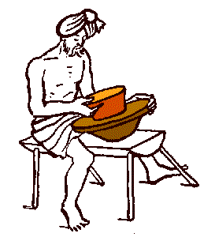
Drawing of an artist using a turntable to help make the pottery process faster

Slide 4
A Brief History of Ceramics…
The use of pottery spread west from East Asia reaching Mesopotamia and the Eastern Mediterranean. It then moved to North Africa around 6000 BC
People were making pottery in Brazil about 5500 BC. These people ate a lot of fish and shellfish and probably used pottery jars to preserve their fish by fermenting it.
West Asian and African people may have begun to make pottery as a way of storing grain safely when they started farming.
Pottery reached Greece about 5000 BC.

Slide 5
An Indian woman carrying grain pots

Slide 6
A Brief History of Ceramics…
Japan has an exceptionally long and successful history of ceramic production. Earthenwares were created as early as the Jōmon period (10,000-300 BC)
Japan is further distinguished by the unusual esteem that ceramics holds within its artistic tradition, owing to the enduring popularity of the tea ceremony.

Slide 7
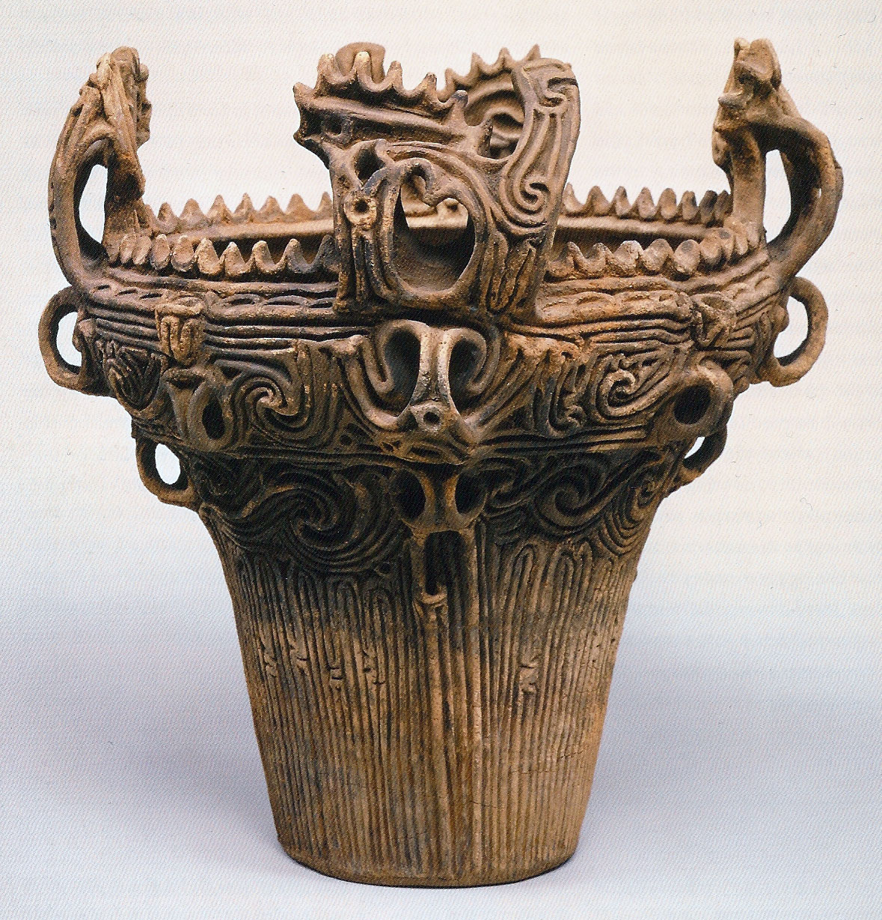
This deep jar is from the Middle Jōmon period (2600-1500 B.C.)
It was used for cooking.

Slide 8
Throwing on the Wheel
Make symmetrical vessels
Graceful shapes and curves
Usable, functional Ceramics
Cups, bowls, vases, etc.
Adding Elements
Texture
Glaze patterns
Cut Out Shapes

Slide 9
How To Throw On the Wheel
Centering the clay
http://www.ehow.com/video_4432609_centering-clay-potters-wheel.html
Opening the clay
http://www.ehow.com/video_4432611_opening-clay-potters-wheel.html
Pulling the clay
http://www.ehow.com/video_4432614_pulling-clay-potters-wheel.html

Slide 10
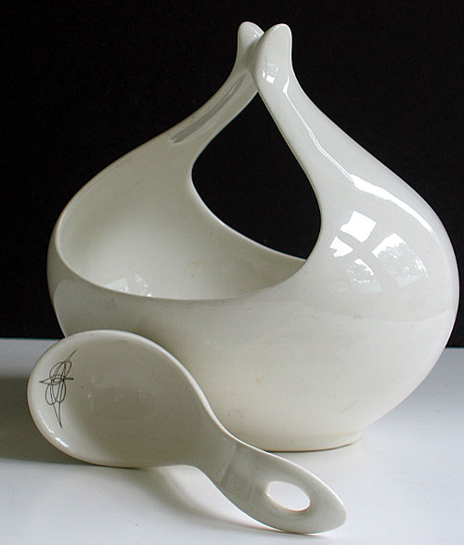
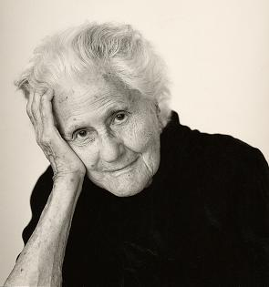
Eva Zeisel was born in Budapest, Hungary on November 13, 1906.
Over the last 86 years, she has become a world renowned and honored designer.
The most prestigious of all Eva's accolades came in 2005 when she received the National Design Award for Lifetime Achievement by the National Design Museum, Smithsonian. At 99 years old, she could have used the award to bring closure to a very successful and productive career, however, Eva chose to continue to design new works of art to share with all of us.

Slide 11
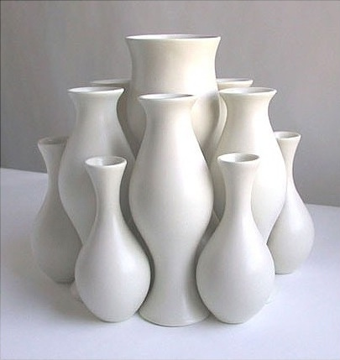

Slide 12
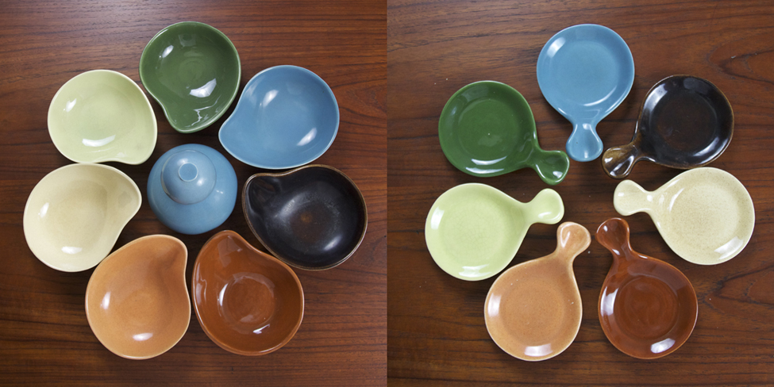

Slide 13
Jennifer McCurdy
Wheel Thrown Porcelain Artist on Martha's Vineyard. Award winning Artist & Educator with many works in permanent gallery exhibits.
After throwing my vessel on the potter's wheel, I alter the form to set up a movement of soft shadow. When the porcelain is leather hard, I carve patterns to add energy and counterpoint.
Some of the finished pieces hold elusive glimpses of the balance between the convex and the concave, and light absorbed and reflected.

Slide 19
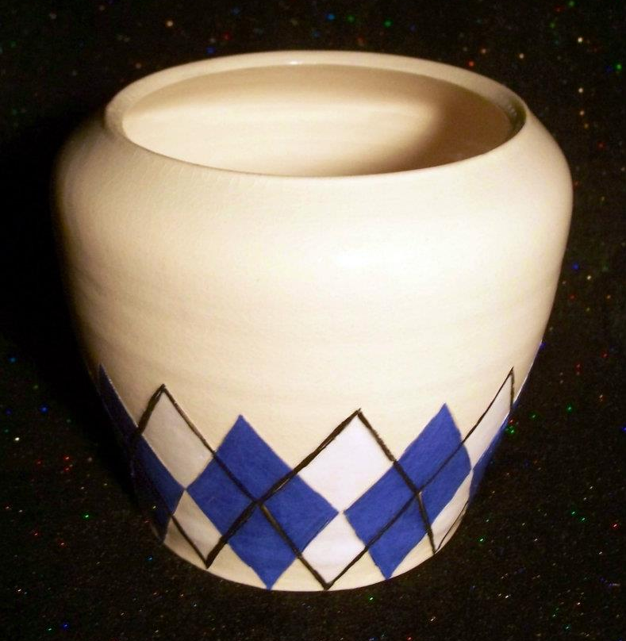
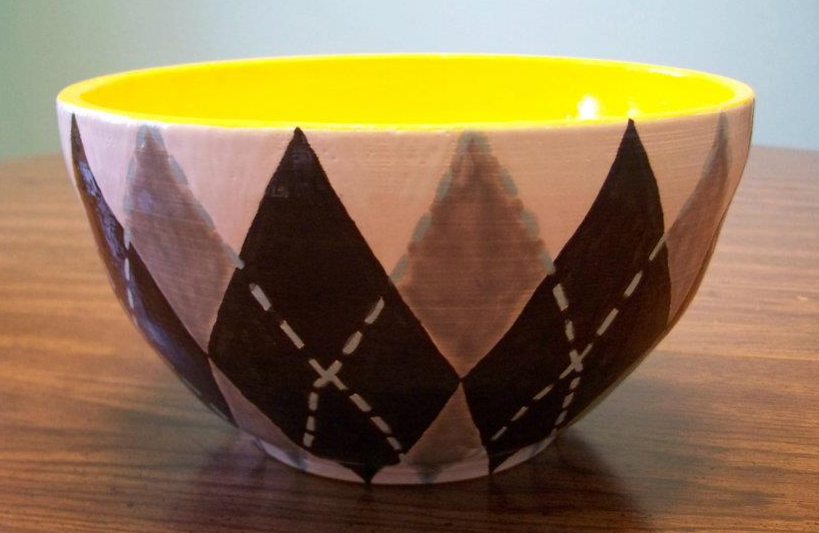
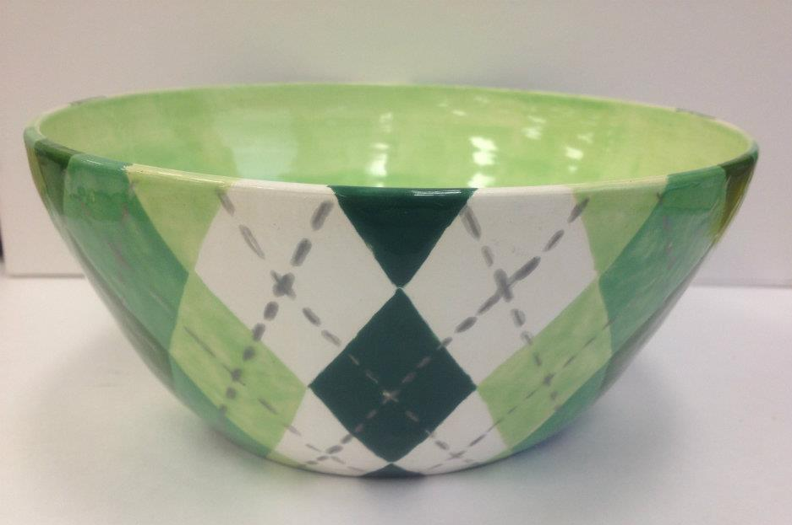
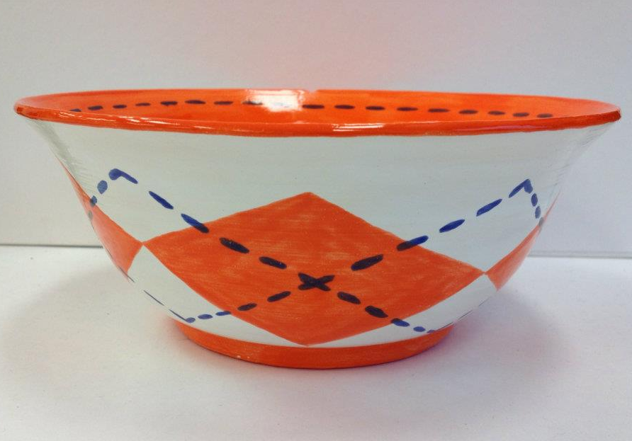

Slide 20
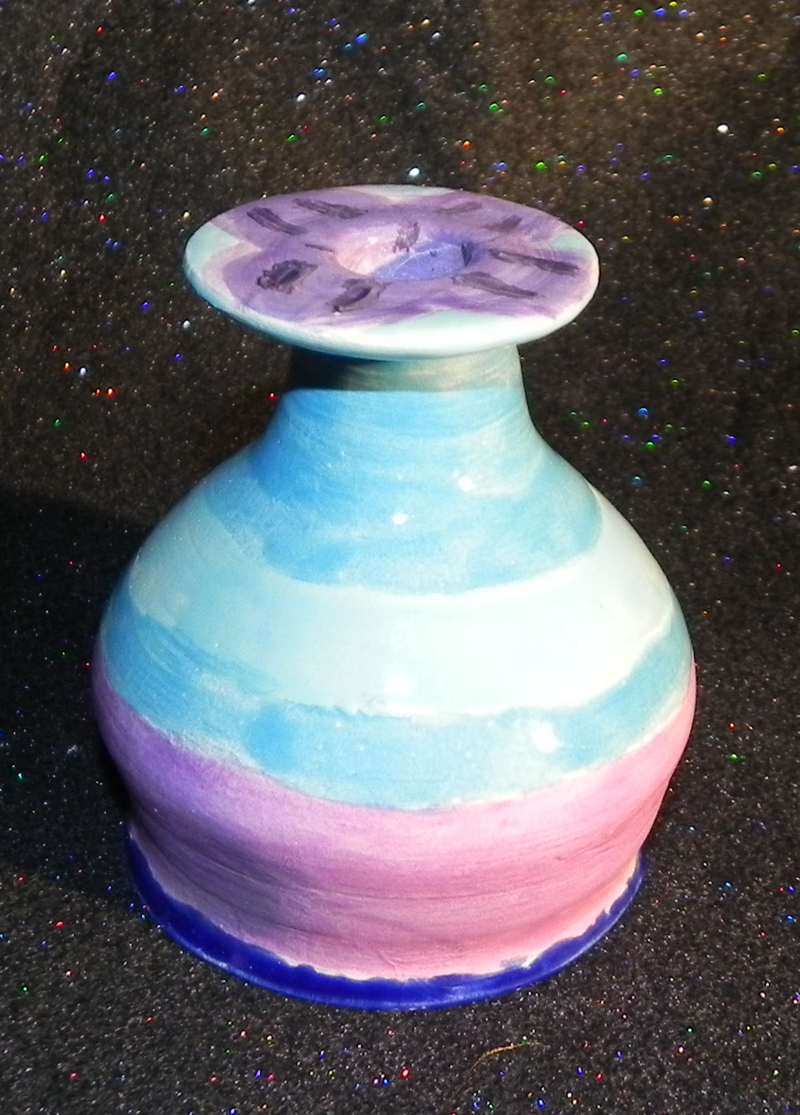

Slide 22
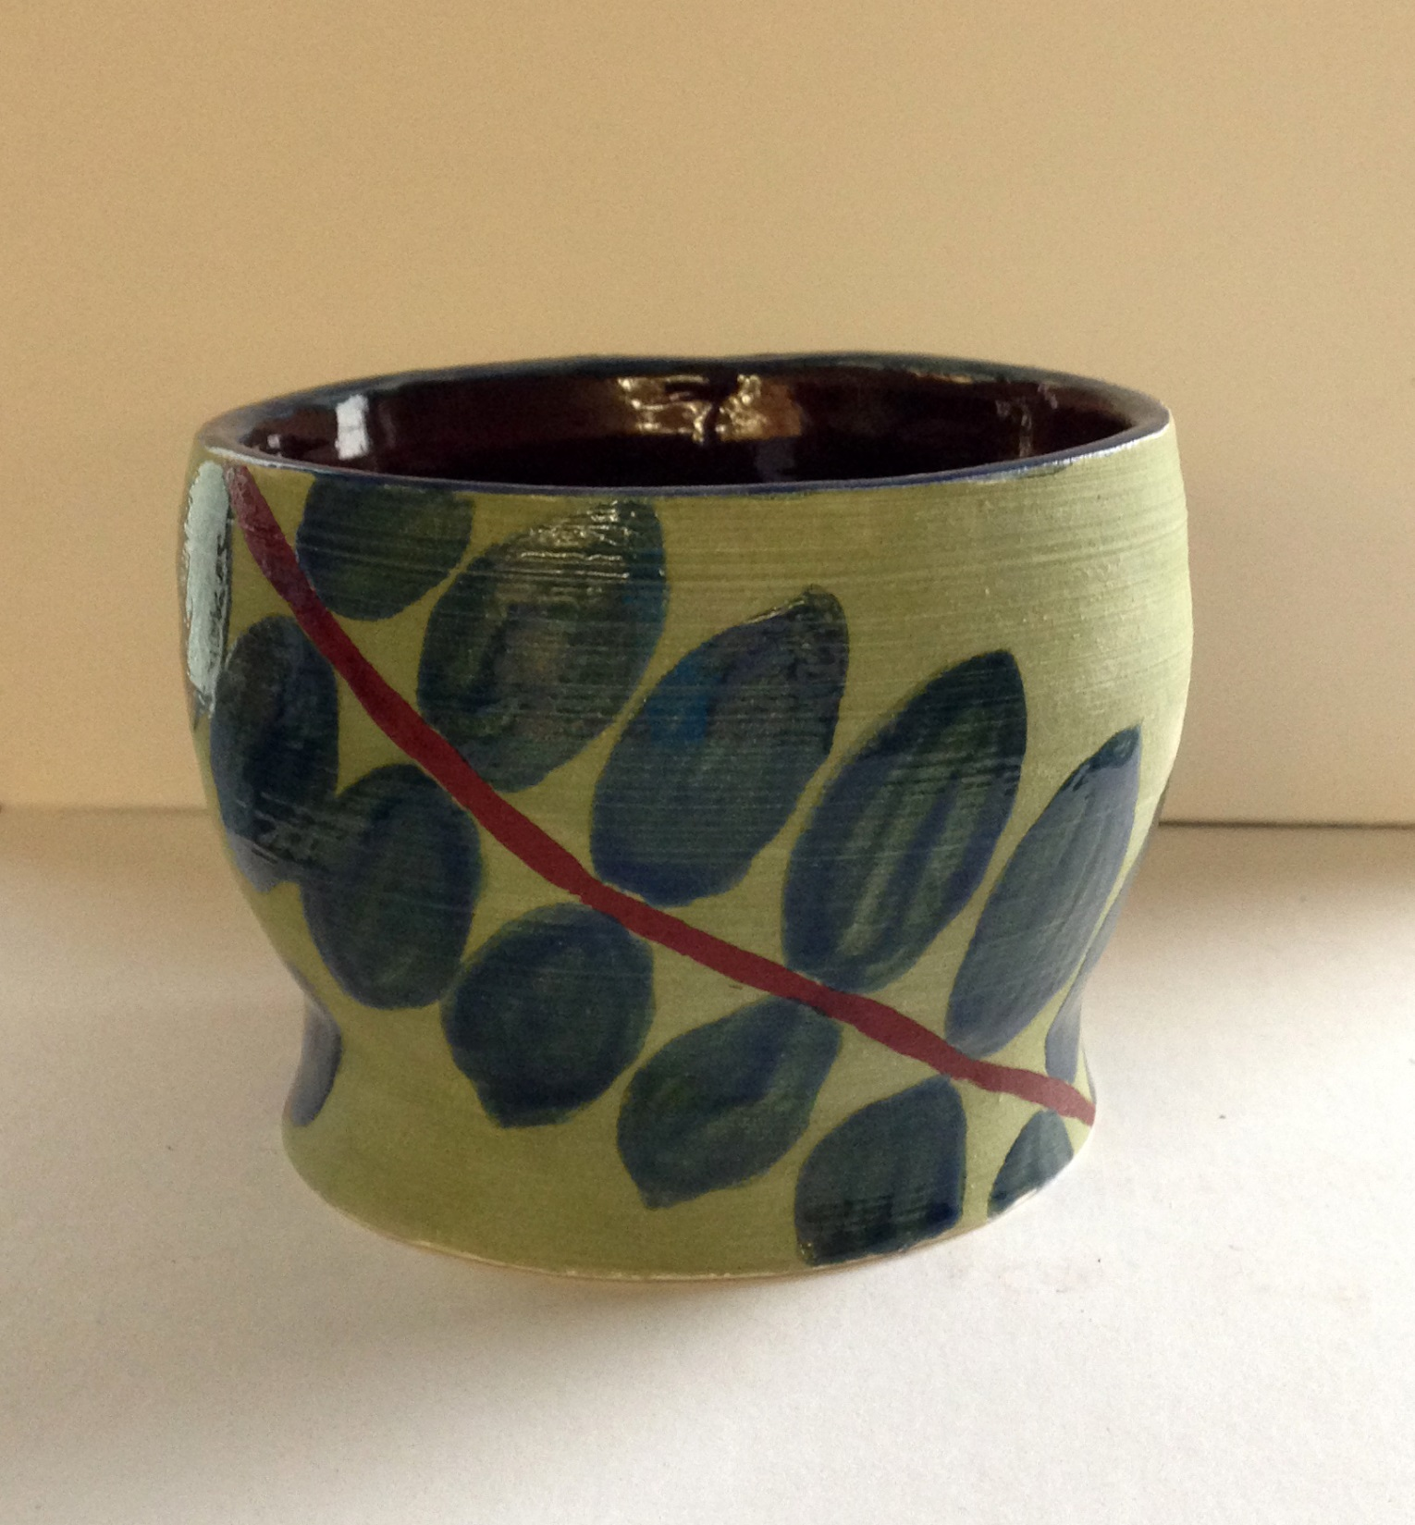

Slide 23
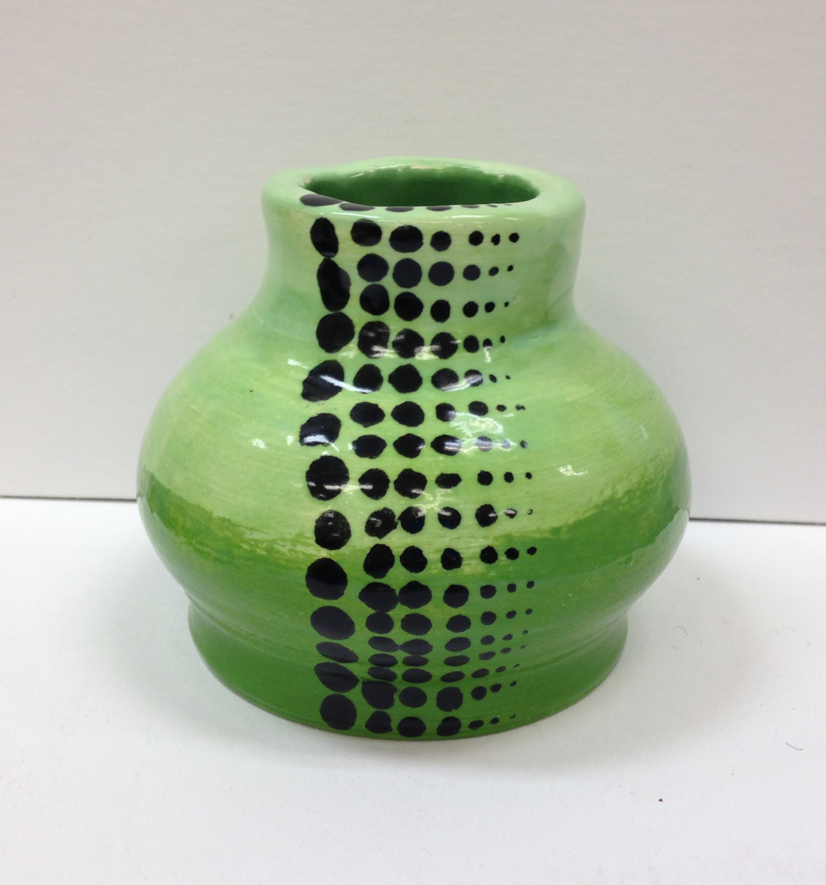

Slide 24
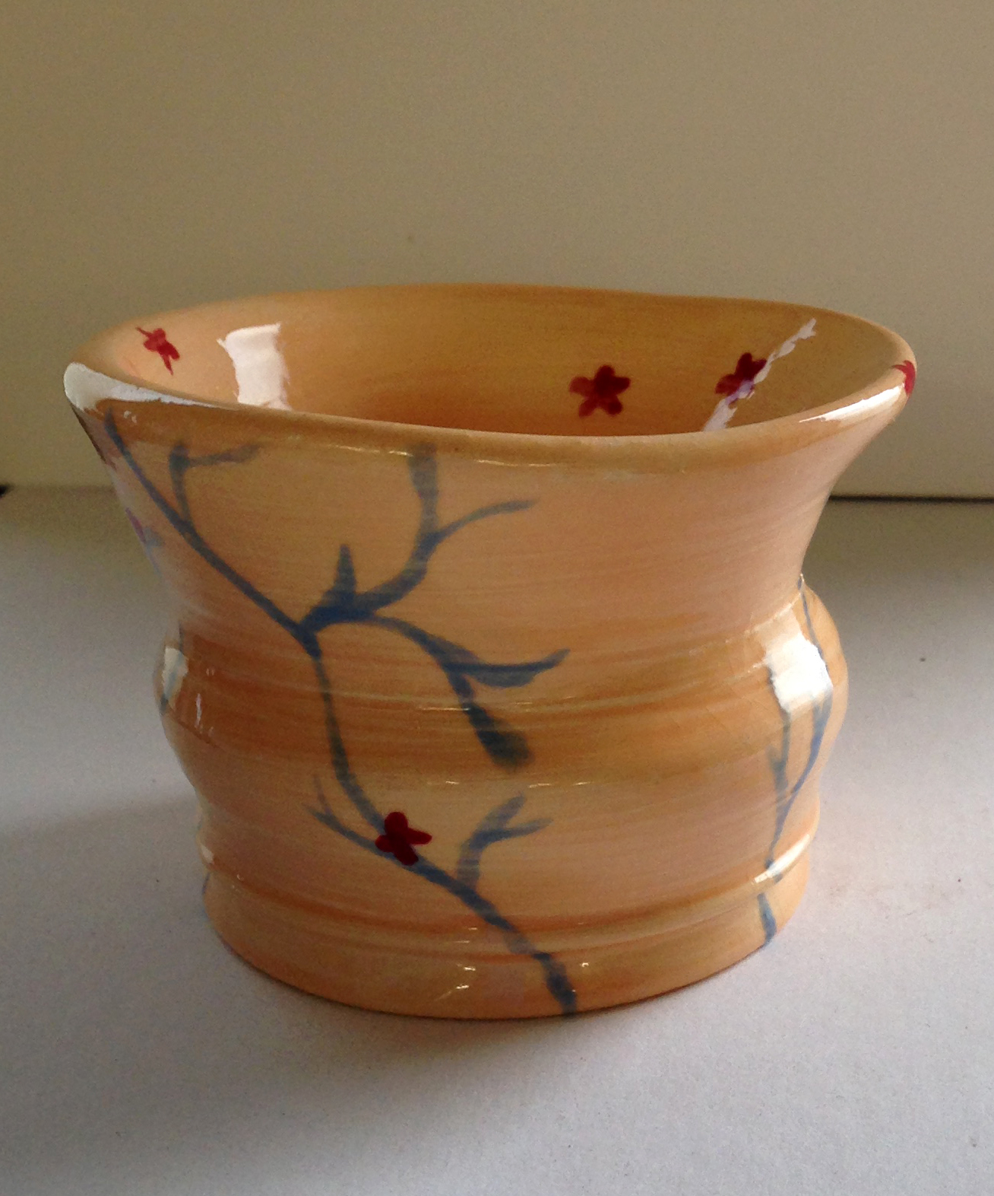

Slide 25
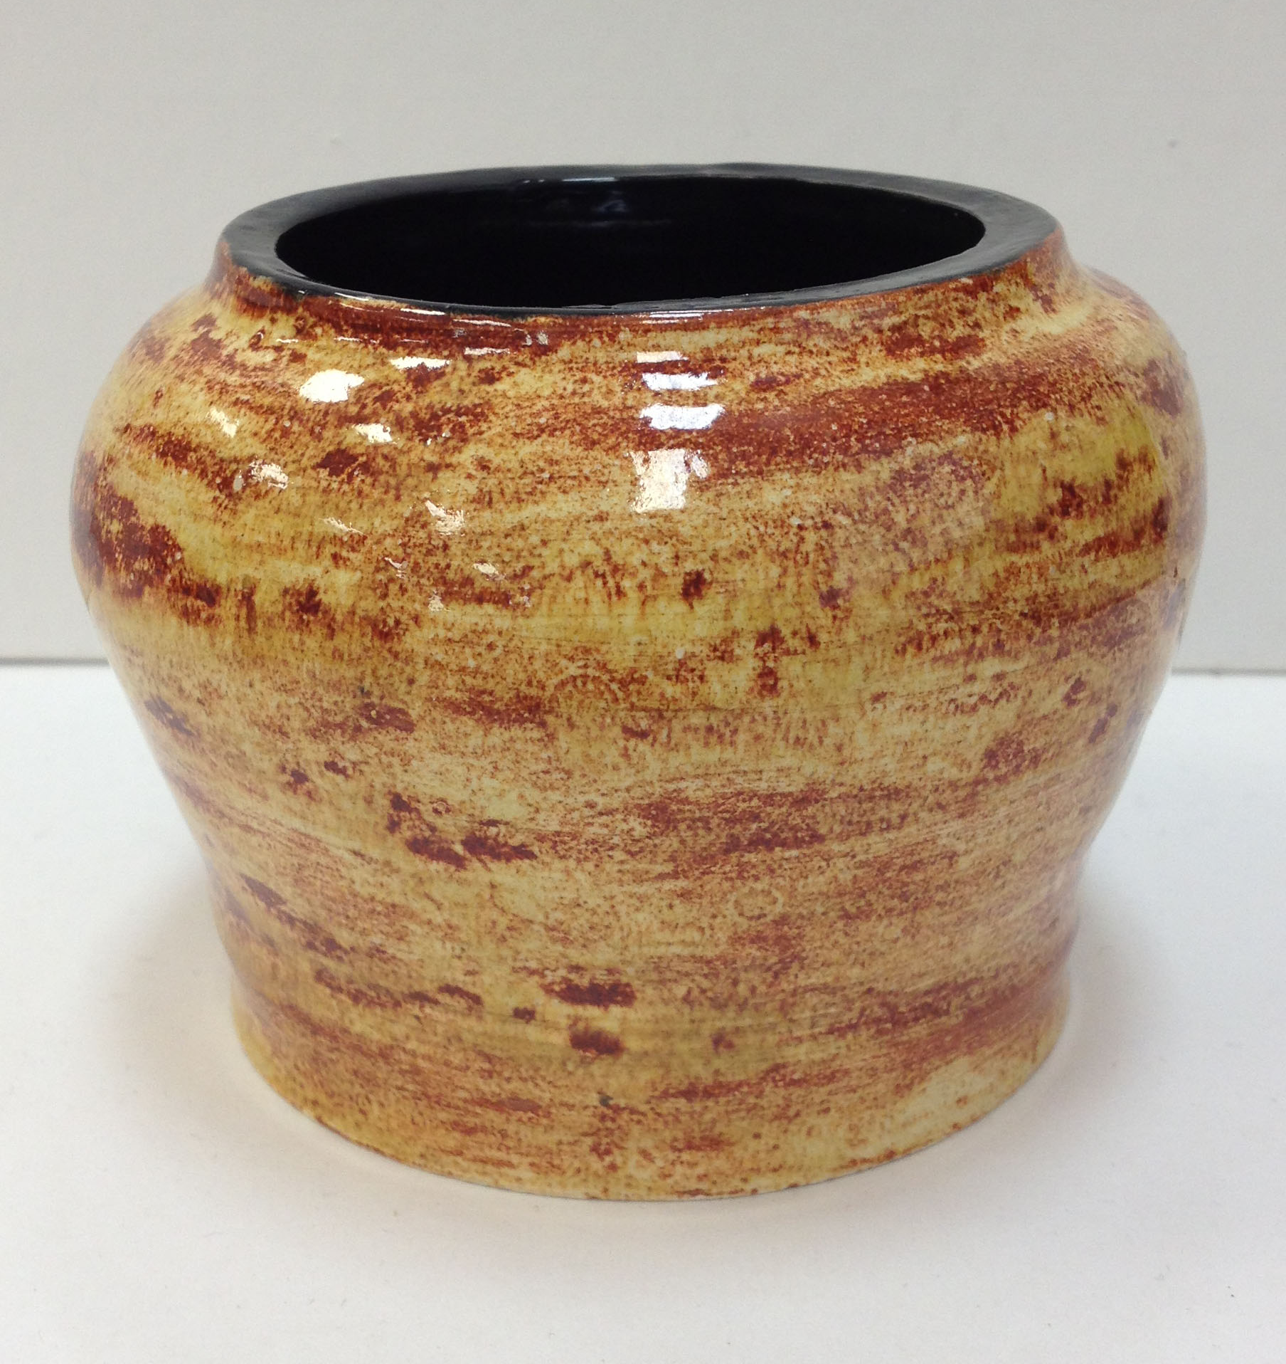

Slide 26
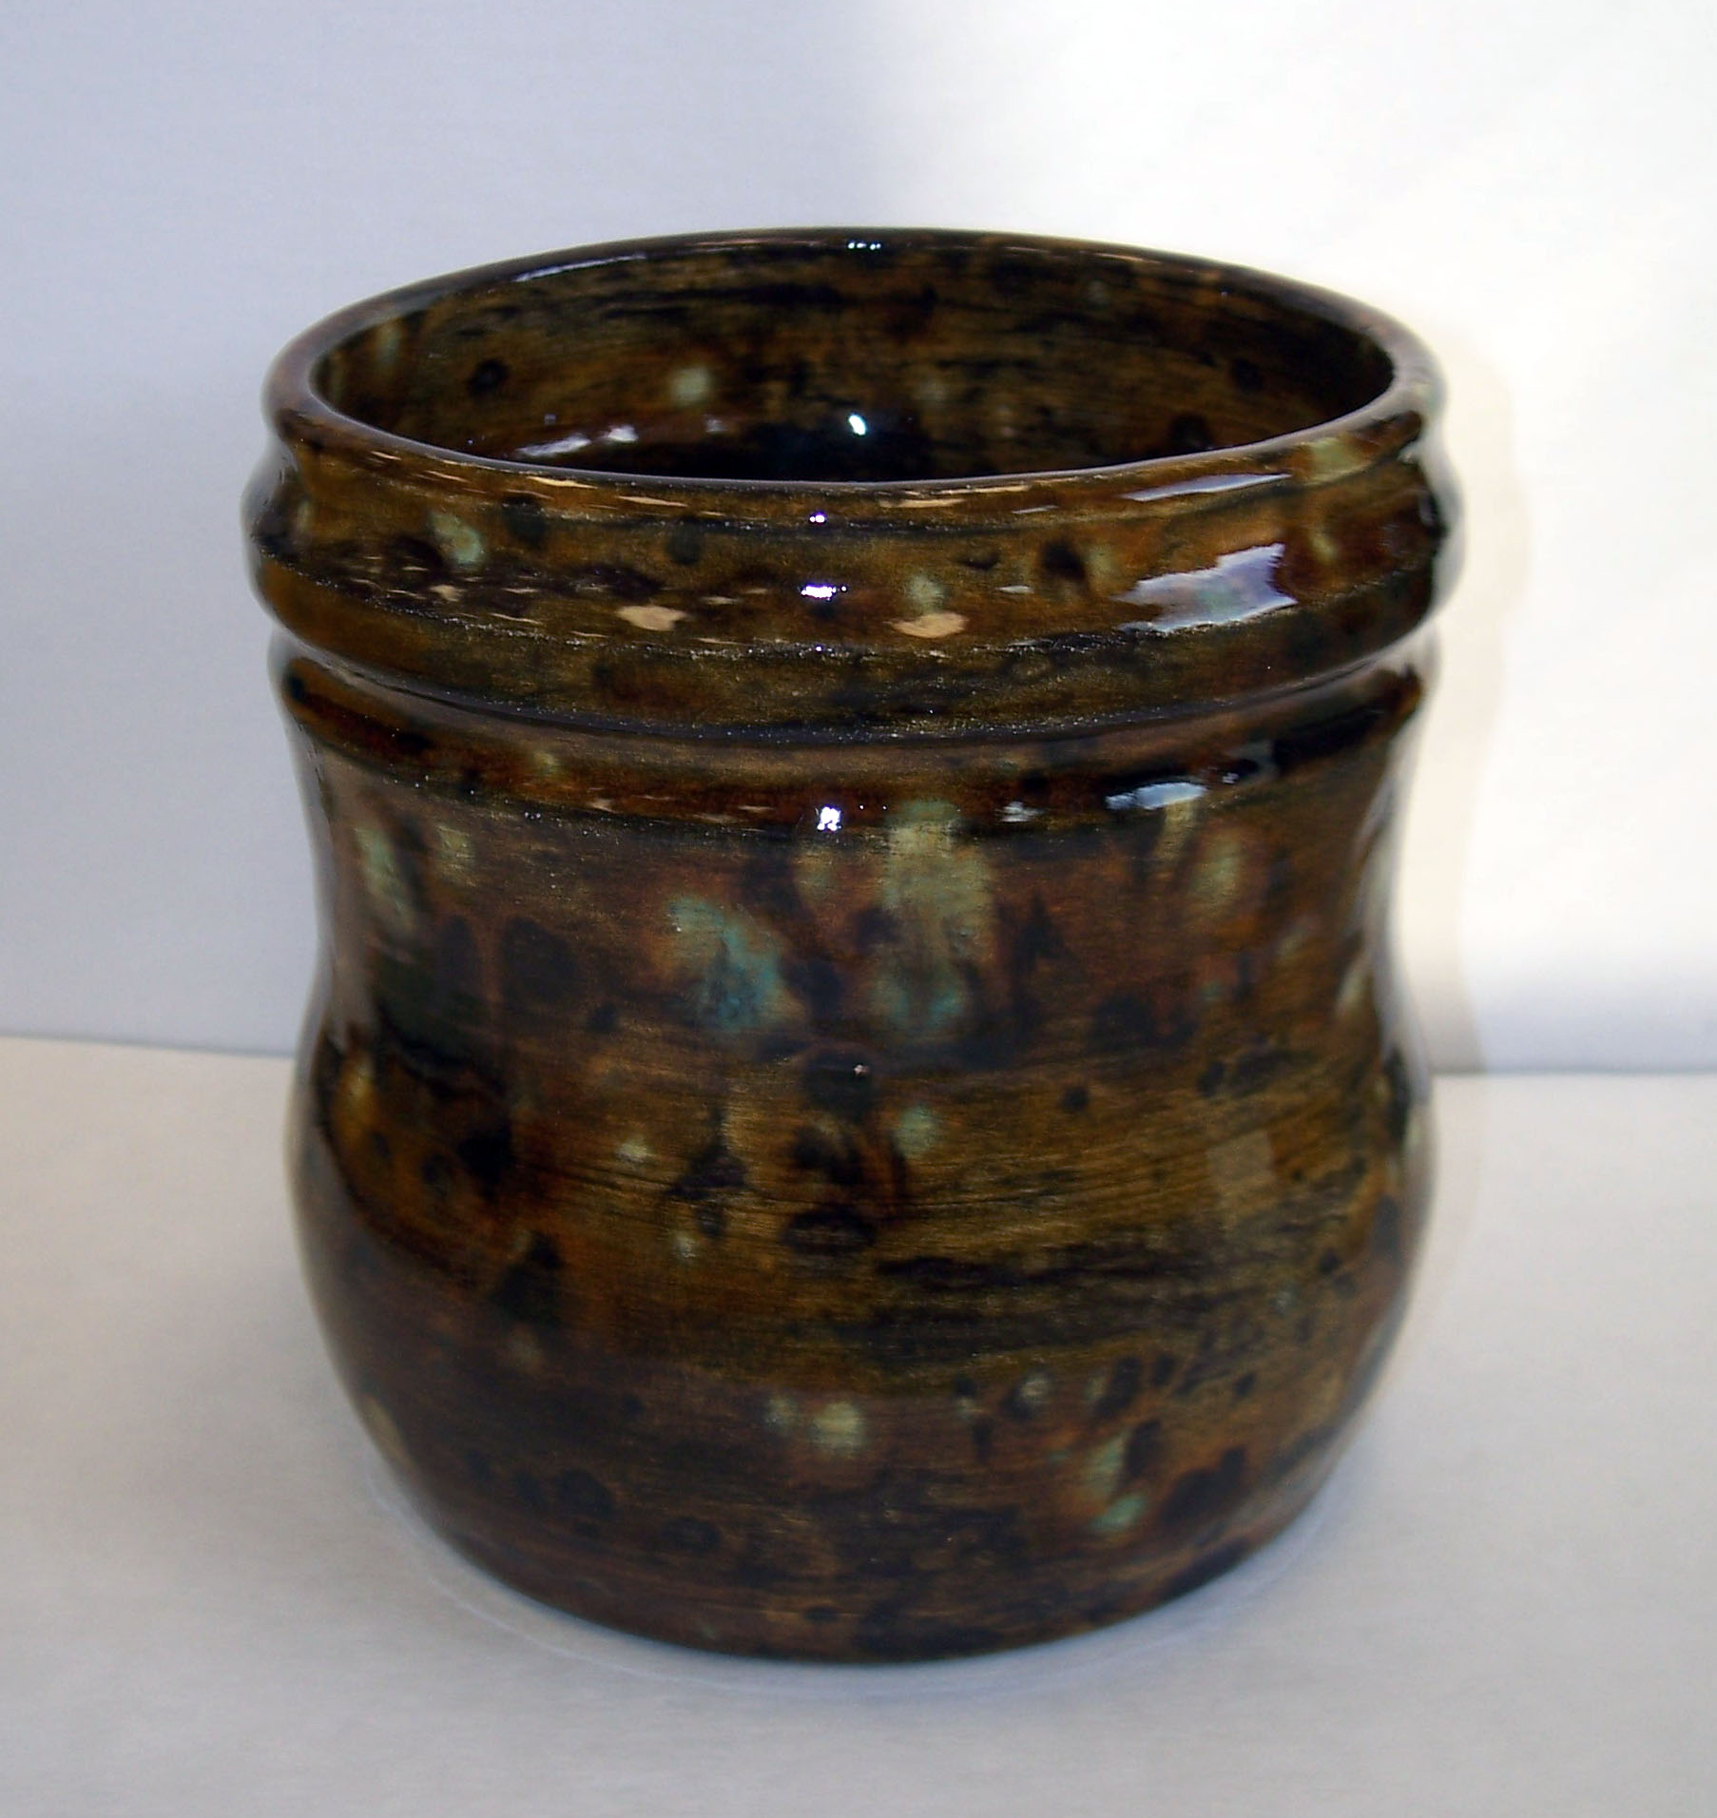

Slide 27
