Slide 1
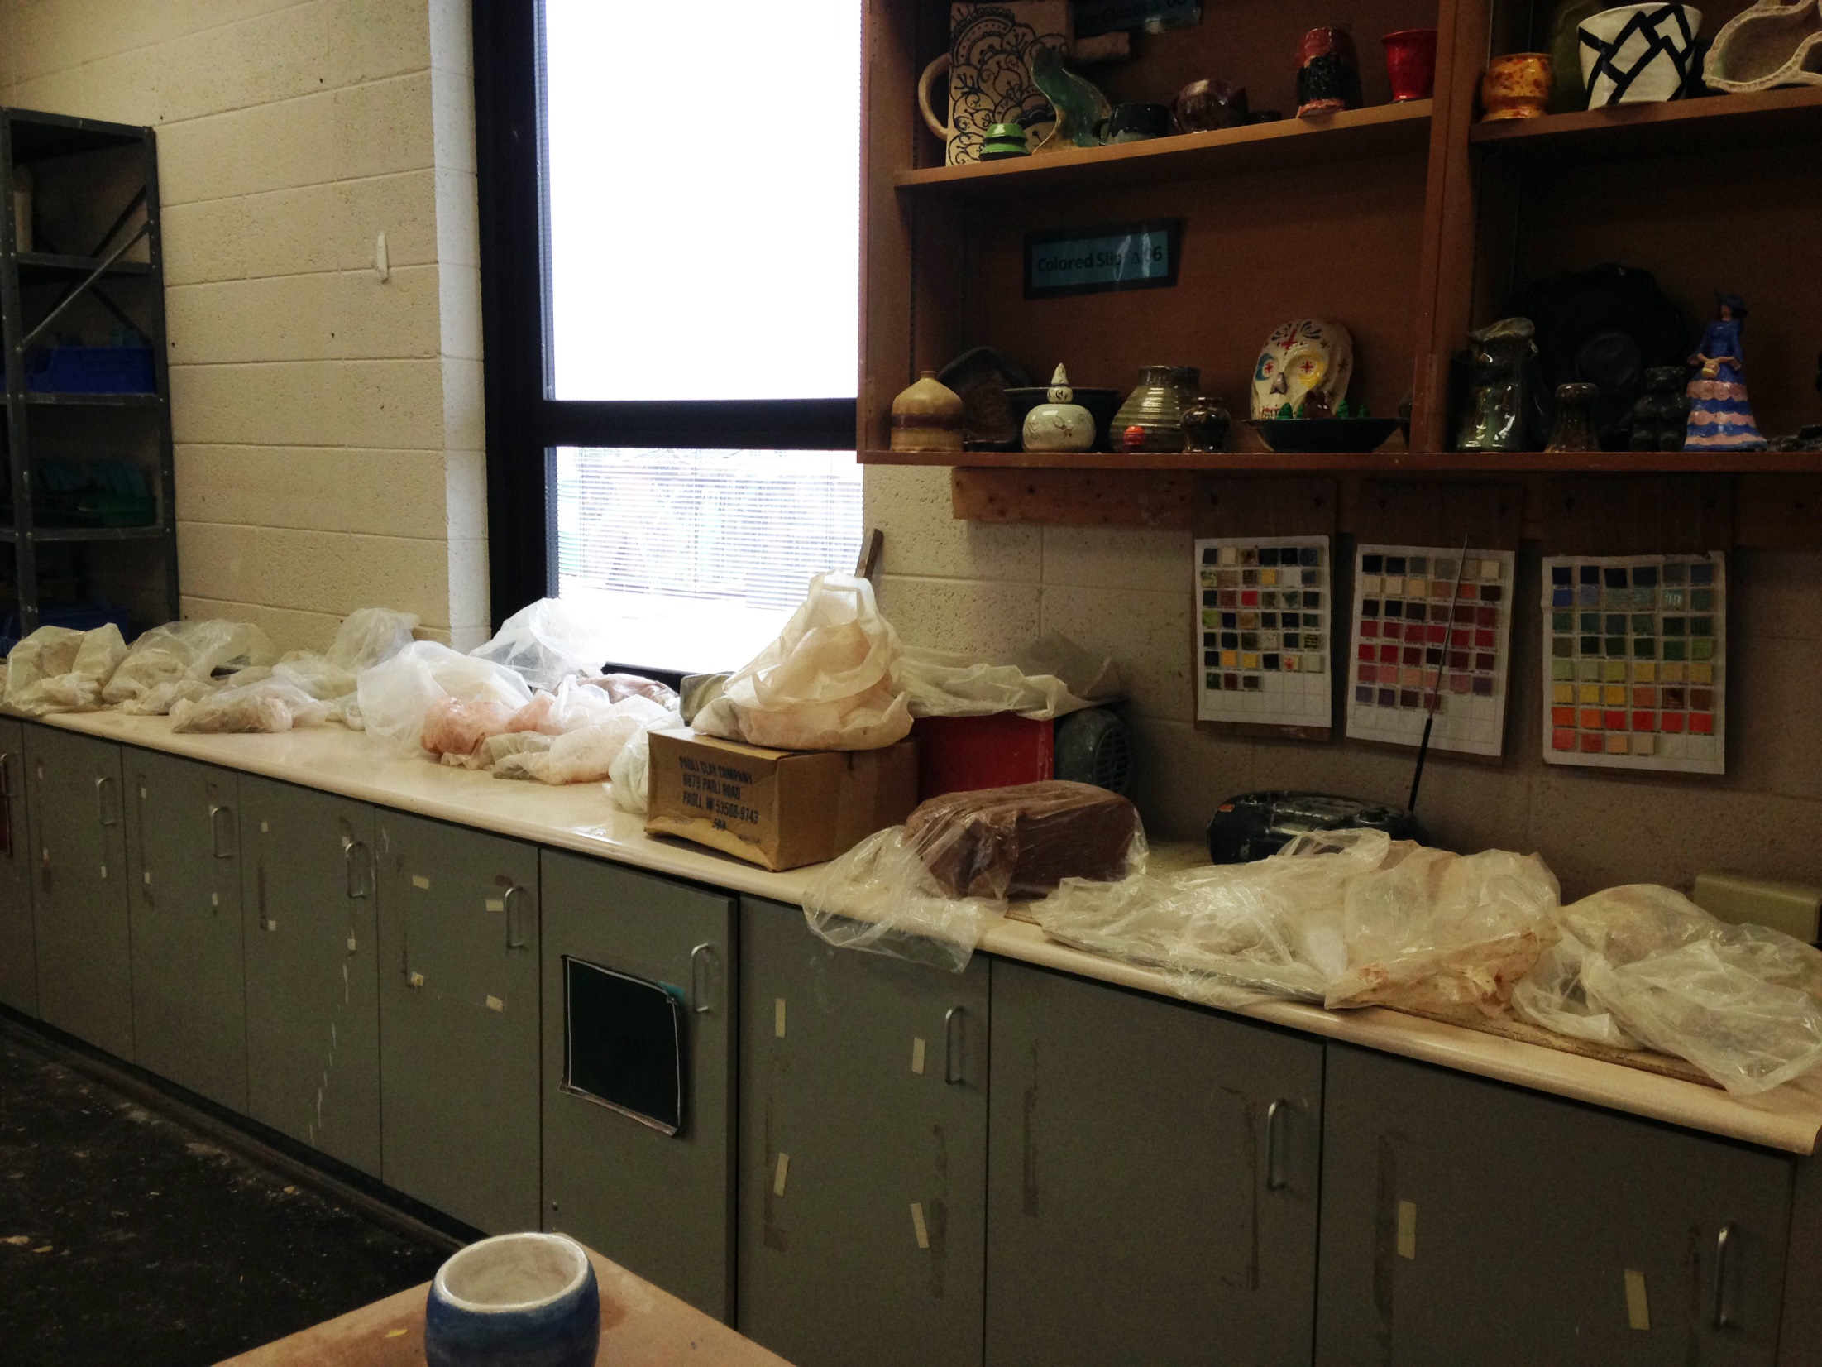

Slide 2
Ancient Art of the Mimbres Culture
● Southwestern New Mexico and Eastern Arizona, 1050-1150 A.D.
● ~10,000 ceramic bowls were found from the Mimbres Culture
● Pottery was used as part of a burial custom for their deceased
● The bottom of the bowl was punched out to
“release the spirit”
● Bold designs were painted on white clay slip using Yucca Brushes
● Mimbres iconography depicts:
● animals encountered in daily life
● people in daily routines
● geometric designs.

Slide 3
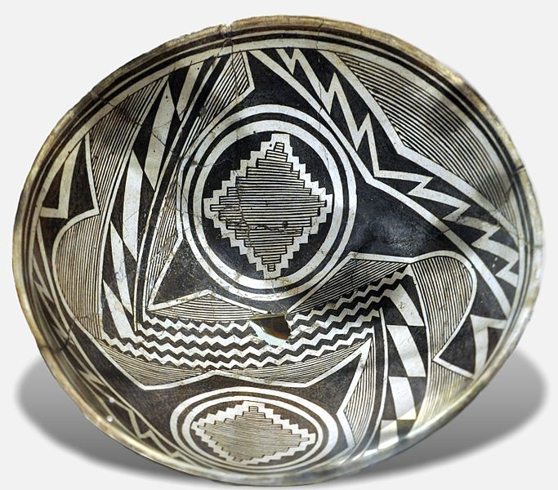
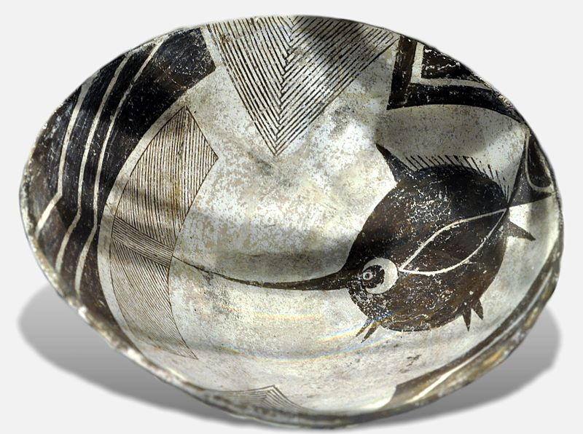
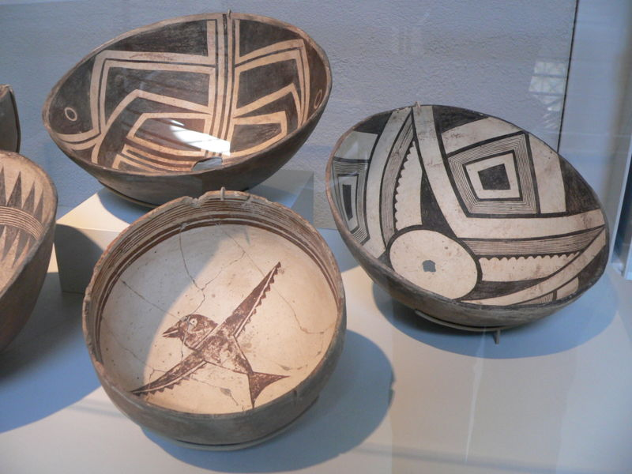
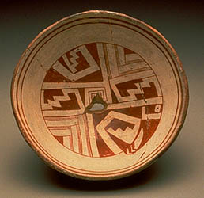
Mimbres Coil Pots

Slide 4
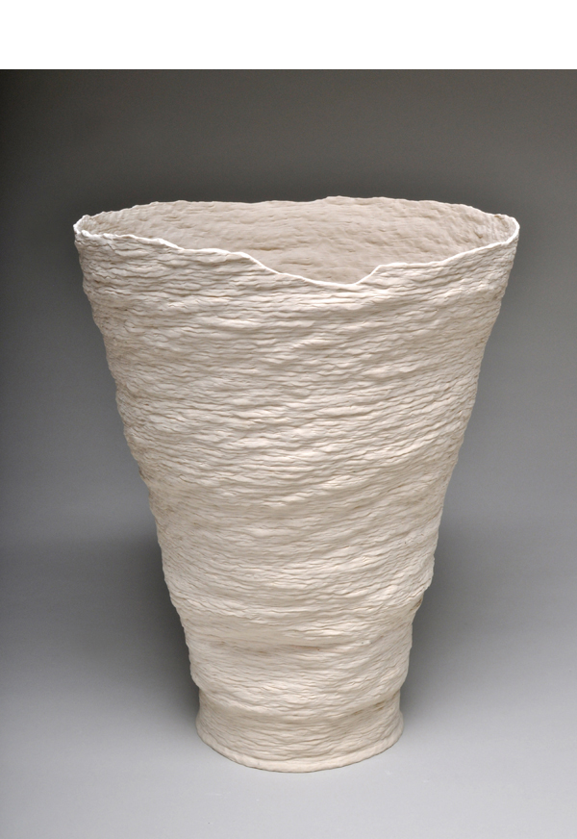
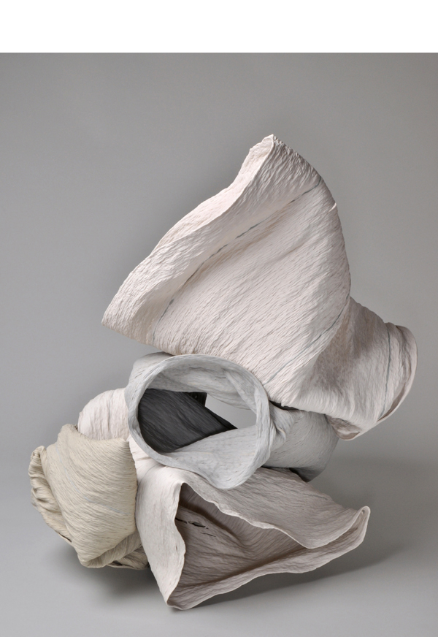
Cheryl Ann Thomas
Soft Exhibit,
Frank Lloyd Wright Gallery
American Artist
2013
Notes:
Coiling together thin, serpentine ropes of porcelain, American artist Cheryl Ann Thomas begins her sculptures with one of the most traditional techniques of pottery. Used by Pre-Columbian, Native American and West African peoples to hand-build large storage jars, coiling has a rich history in the ceramic world. Traditionally the coils were smoothed together and integrated, but Thomas leaves the twists of clay exposed, and imprinted with the mark of her hand.
Once she has constructed tall, thin vessels of coiled porcelain, Thomas fires them, and the weight of the clay causes the works to collapse and fold in on themselves unpredictably. Her early works were the outcomes of this process, while more recently the artist has begun combining these forms and firing them for a second time, creating assembled sculptures of greater scale and power. After firing her pieces and leaving the results to chance, “the resulting forms are exquisite and very delicate, richly open-ended in their associations,” according to Constance Mallinson for Art in America. Thomas’s work is frequently noted for its allusions to the transience and delicacy of existence. Although the heat of the kiln is what causes the collapse of her forms, it also gives the porcelain she uses its durability and strength. In this way, the artist notes that her work “is not a metaphor, but a real and distinct experience of creation and loss.” Thomas has recently expanded her output to include works in bronze and stainless steel, which continue her meditations on fragility.

Slide 5
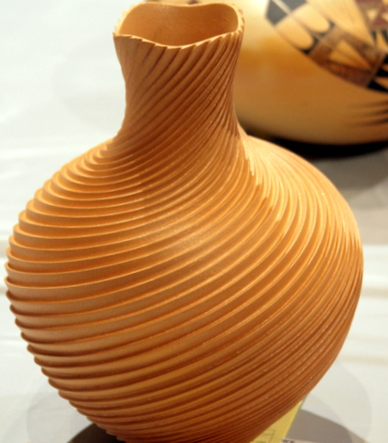
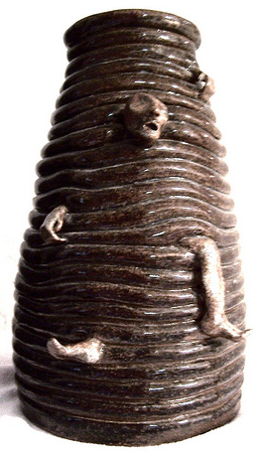
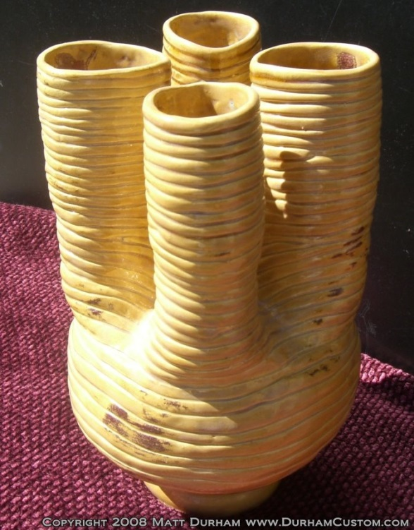
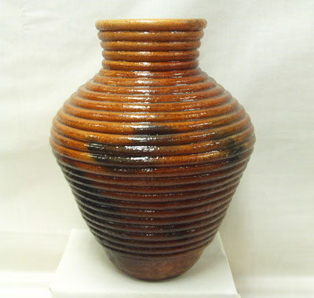
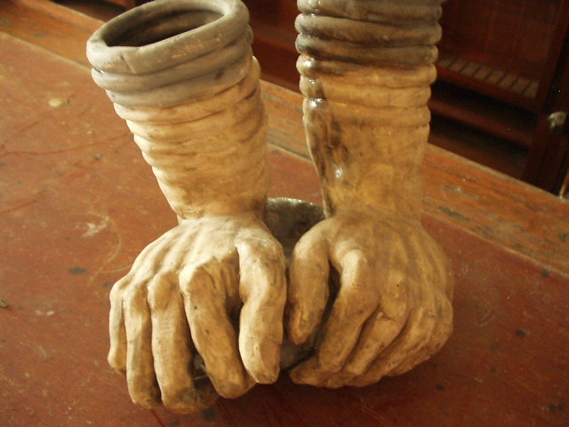
Other Coil Examples

Slide 6
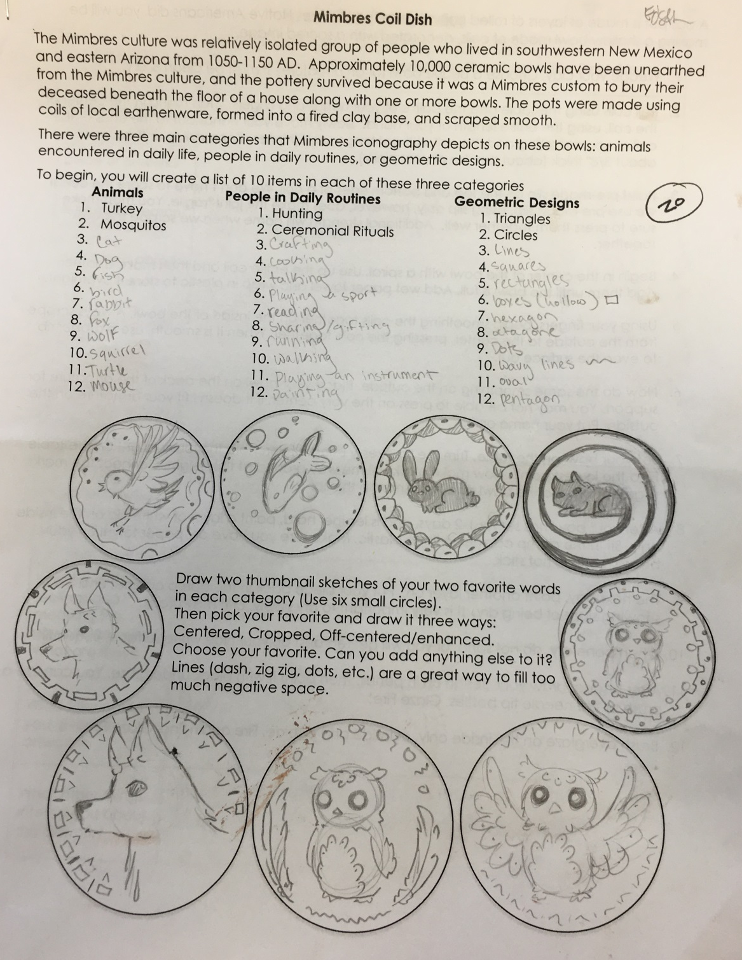
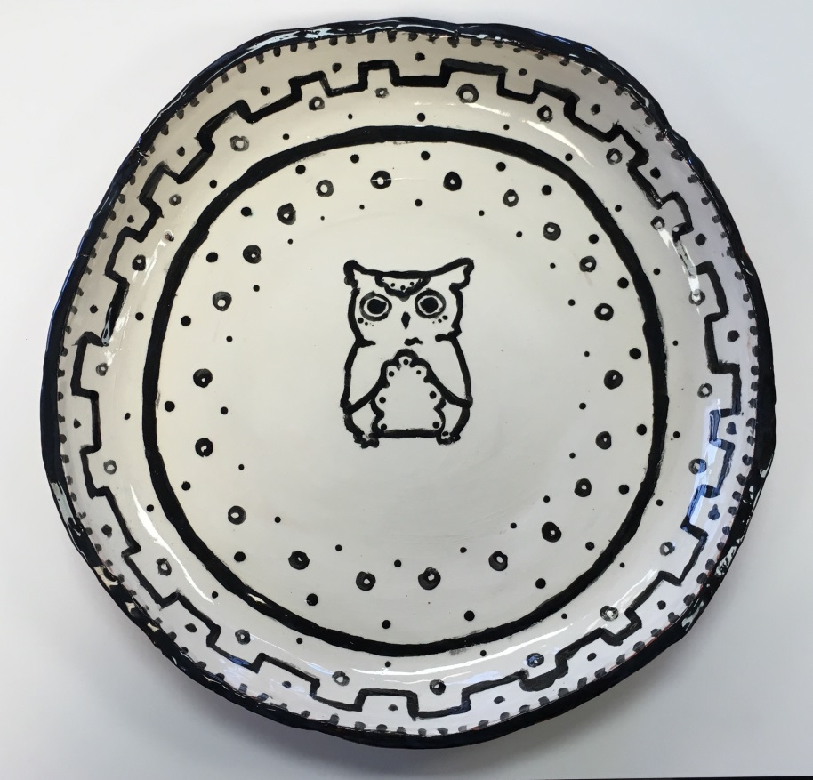
Student Examples

Slide 7
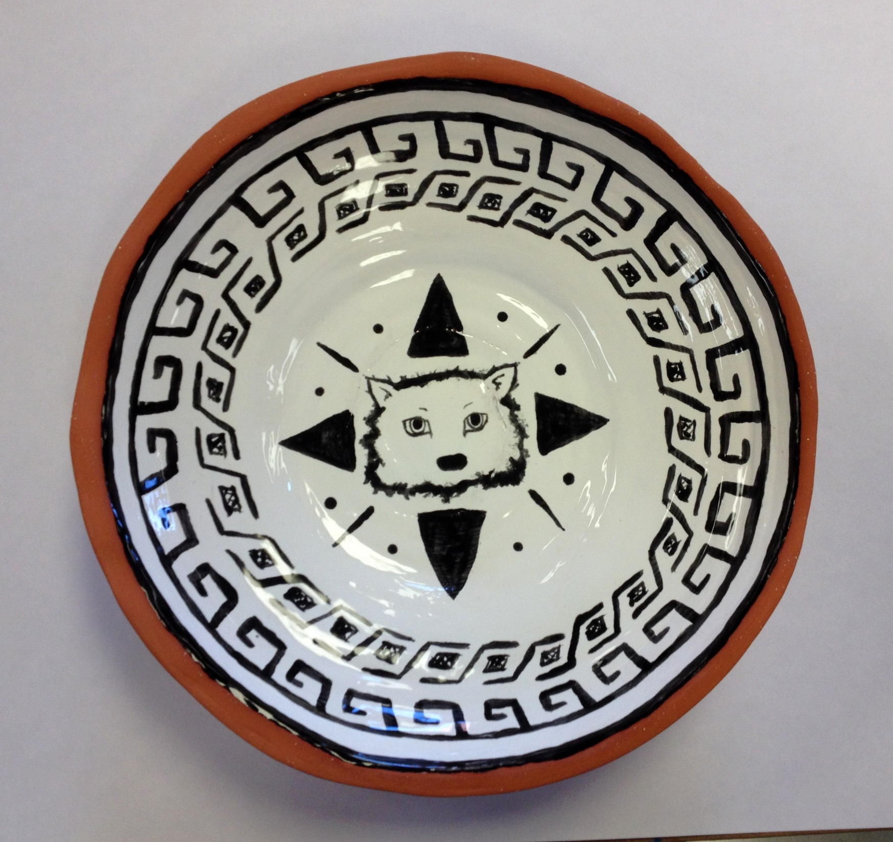

Slide 8
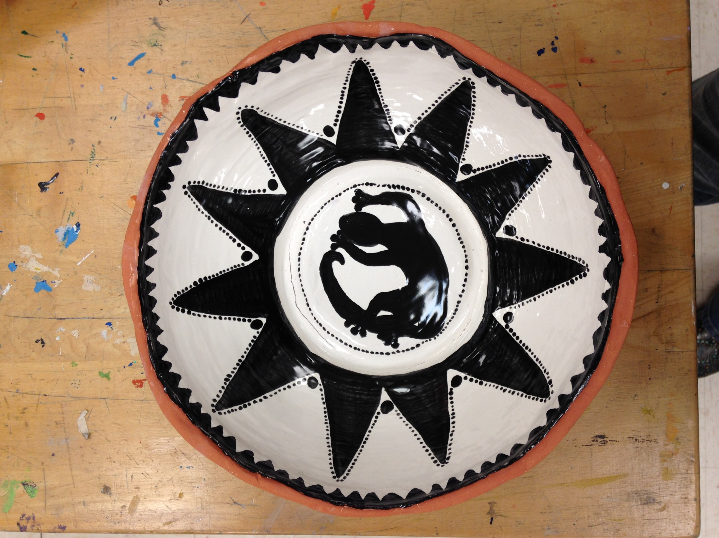

Slide 9
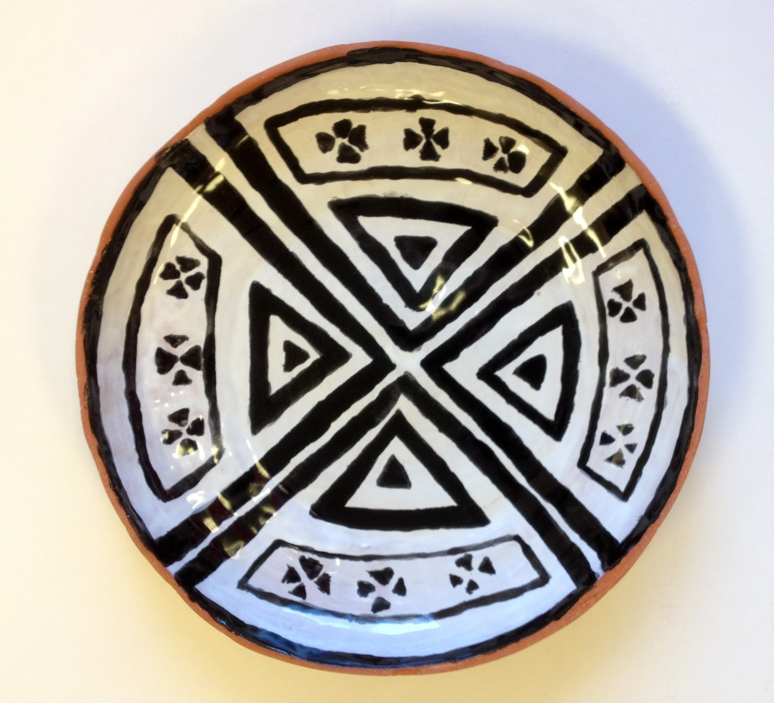

Slide 10
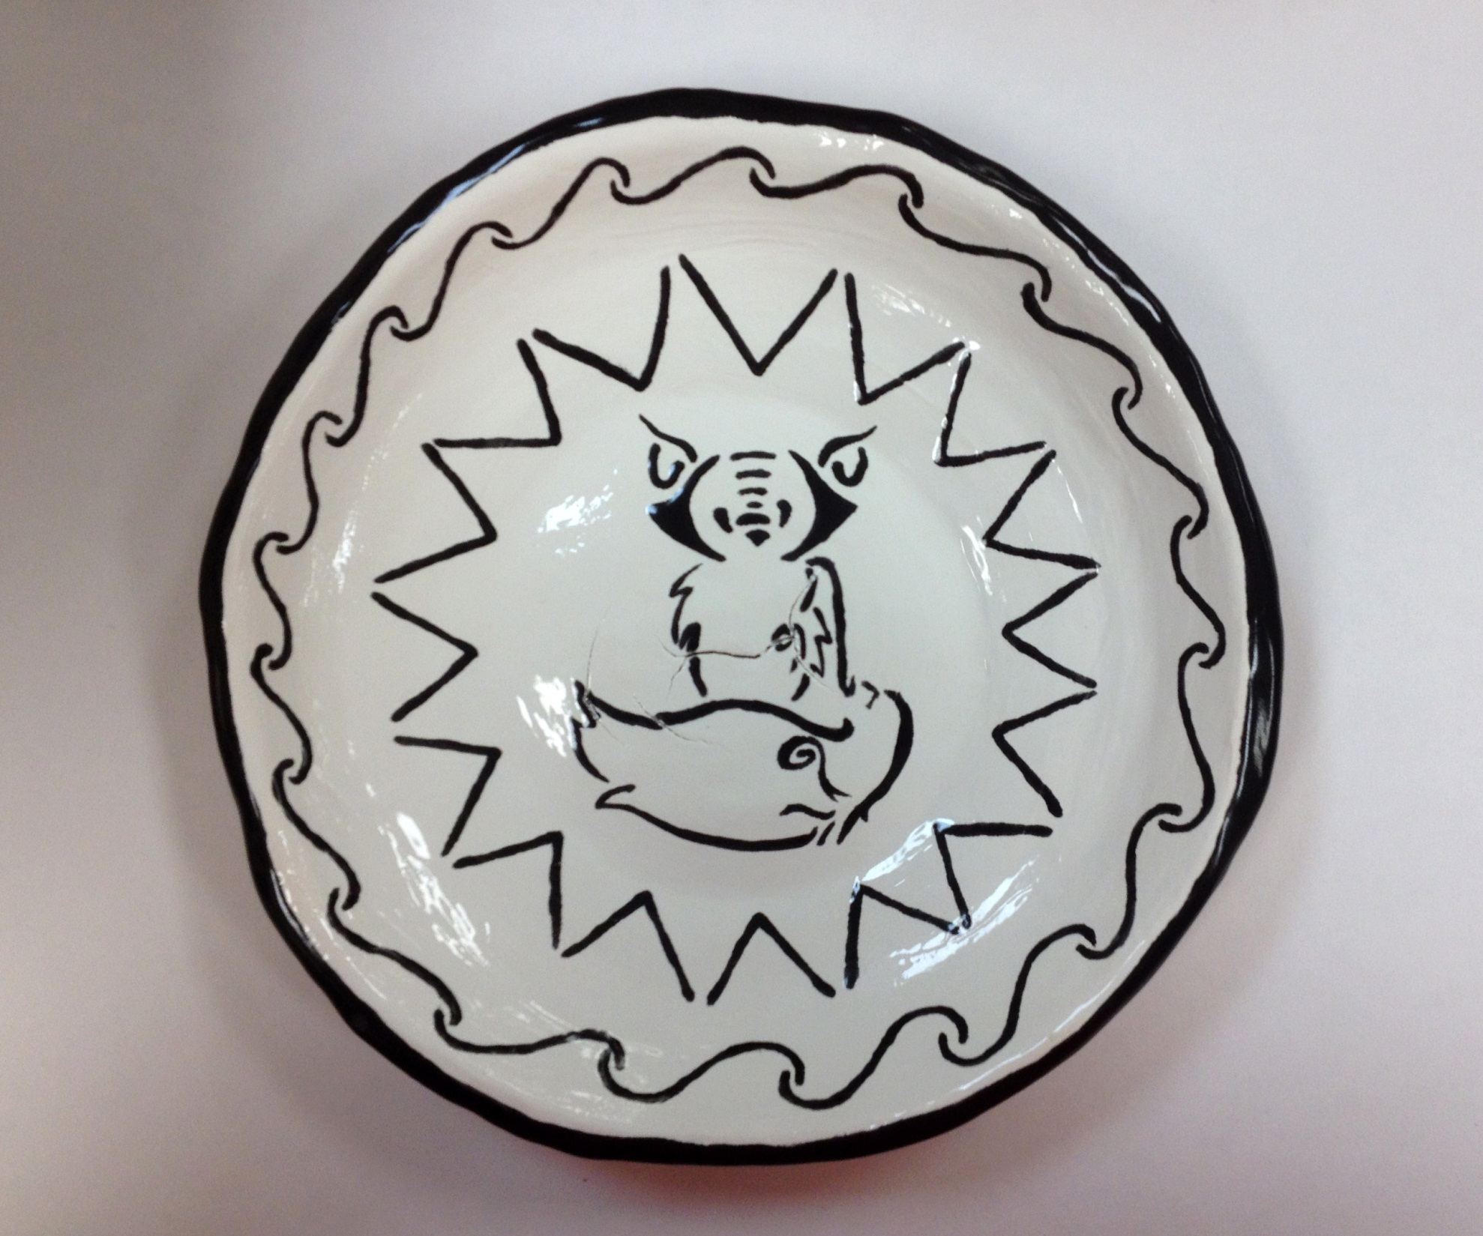

Slide 11
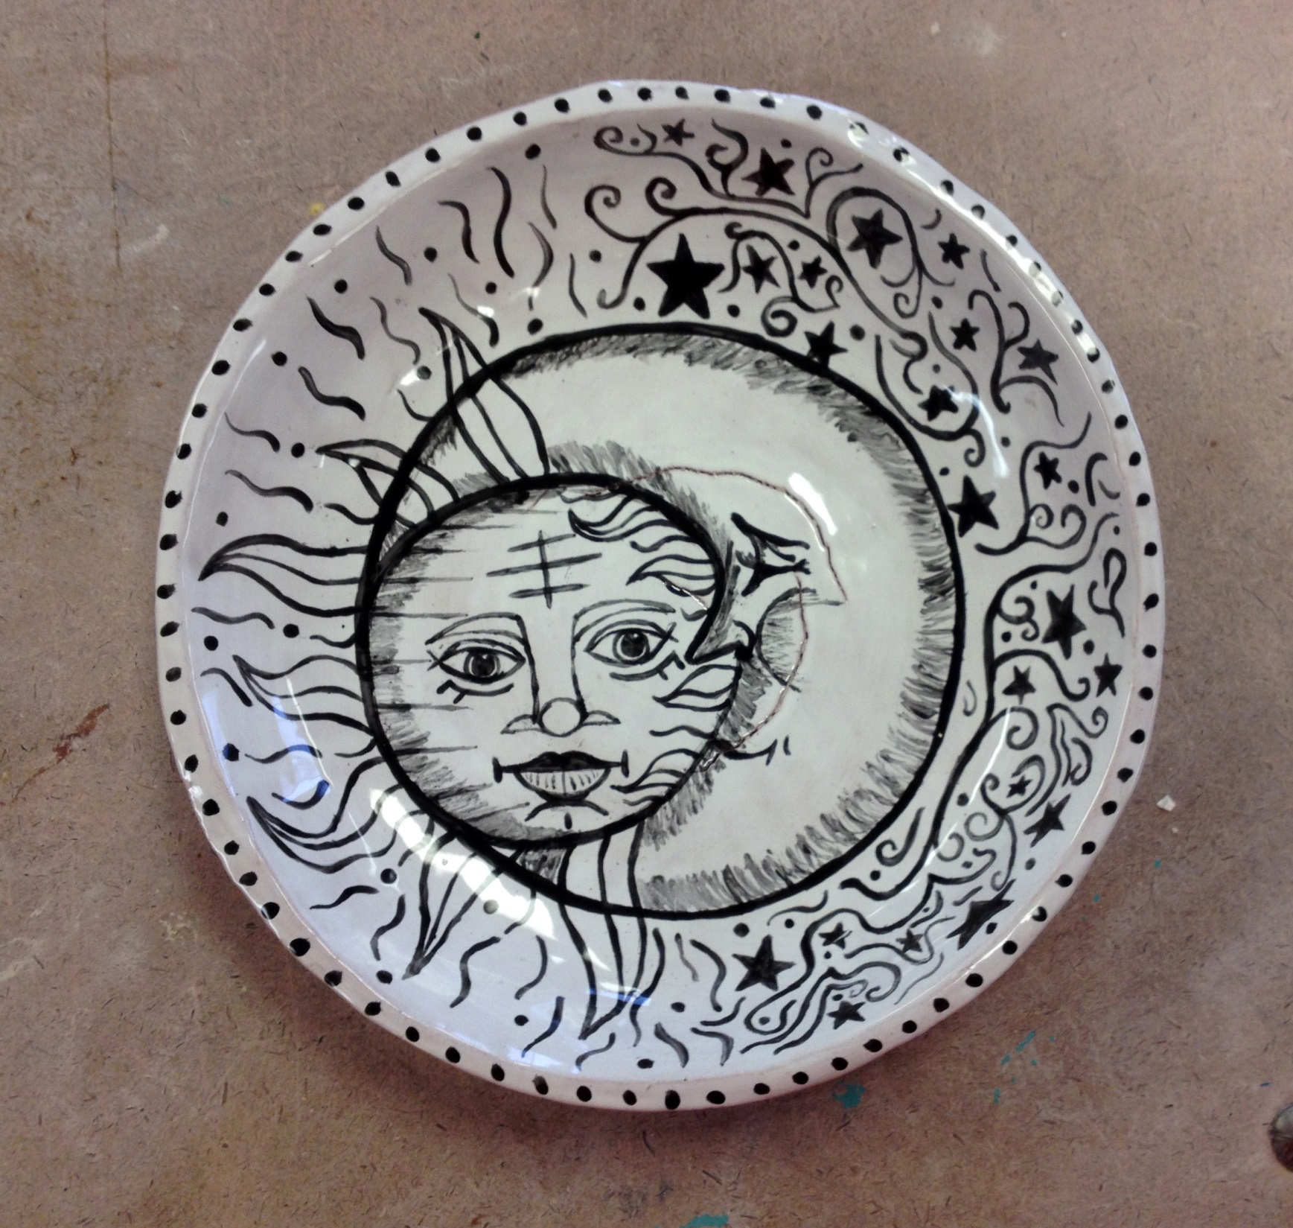

Slide 12
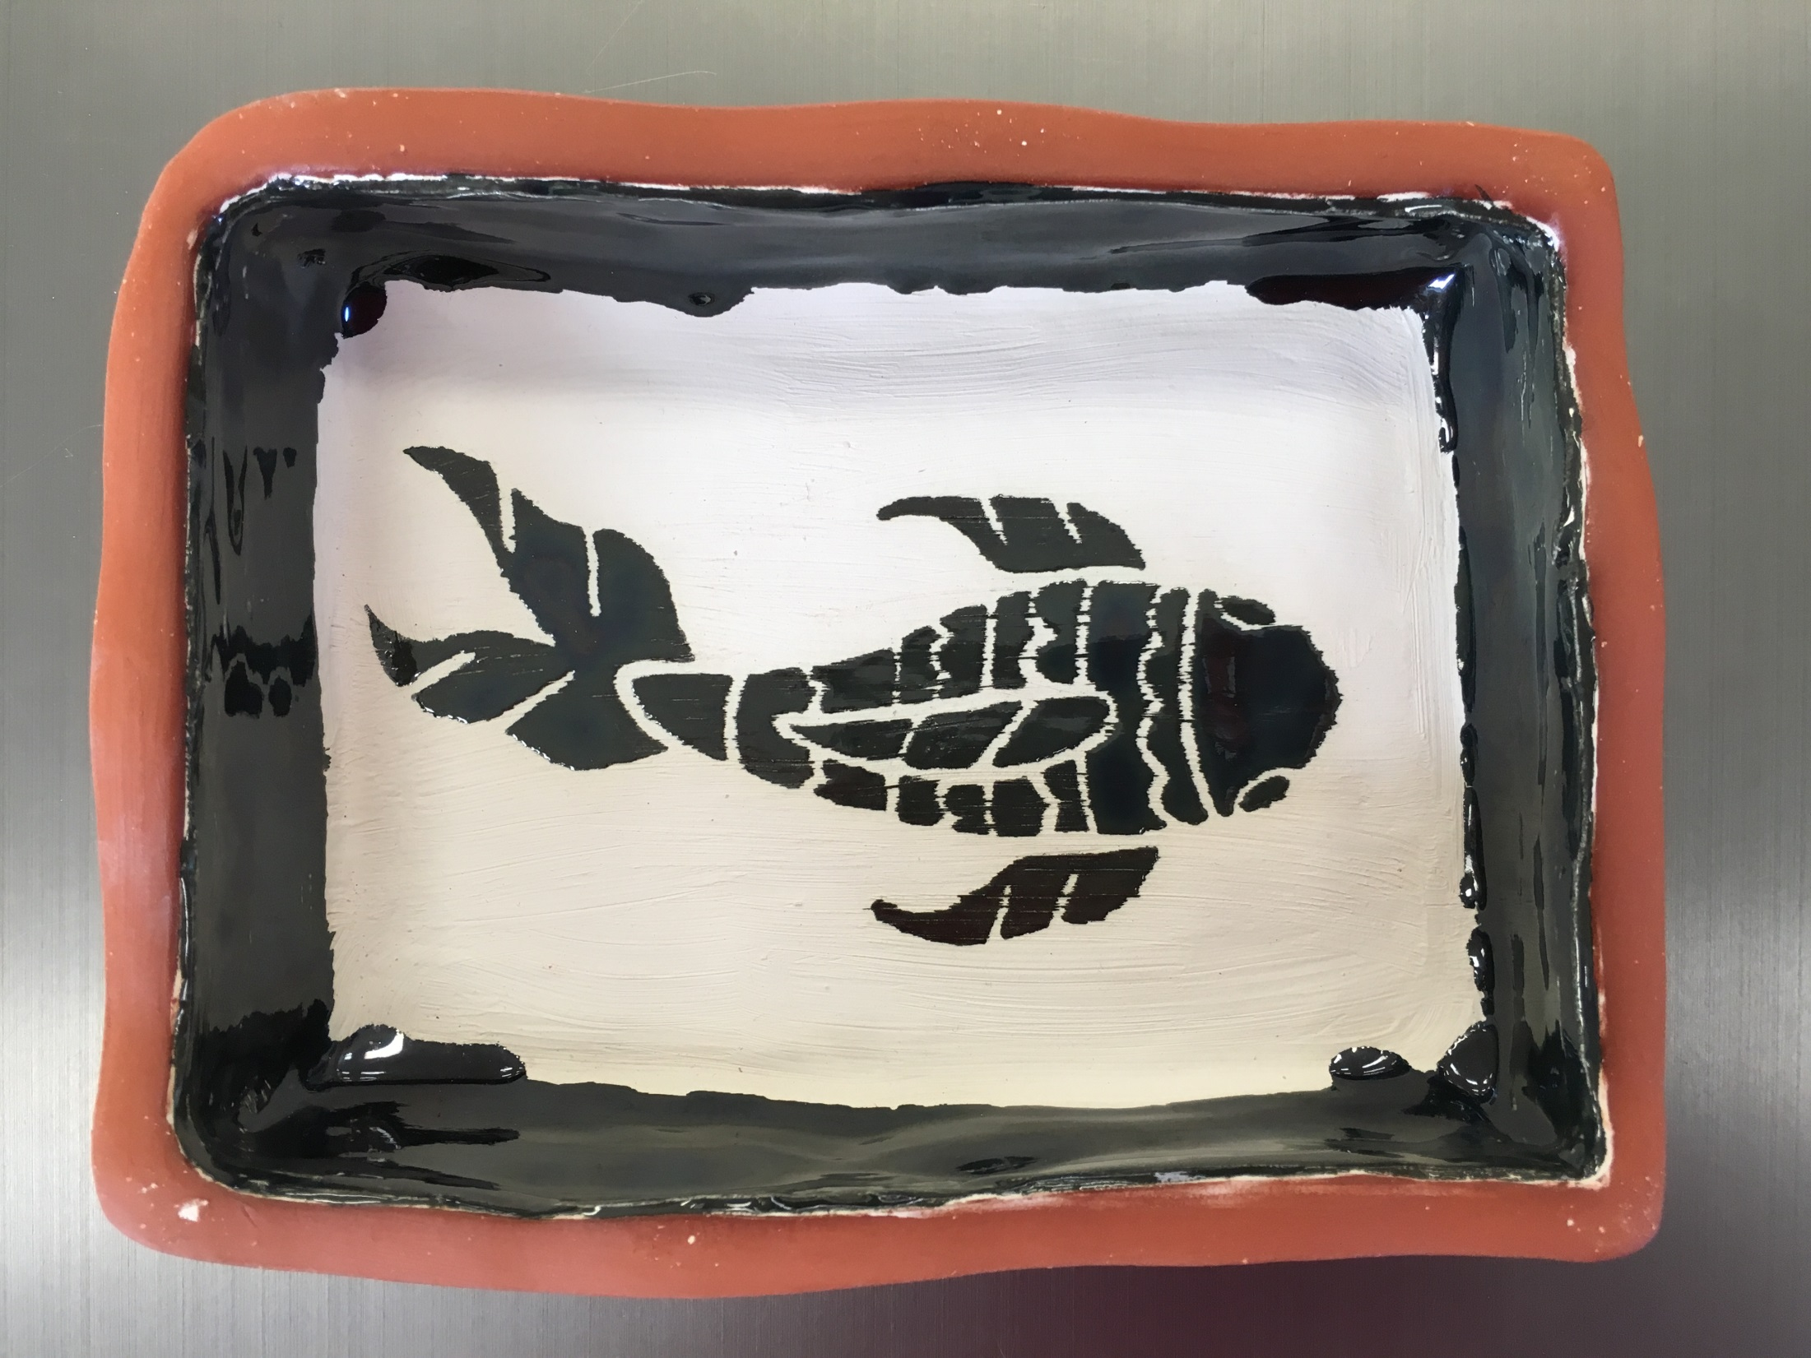

Slide 13
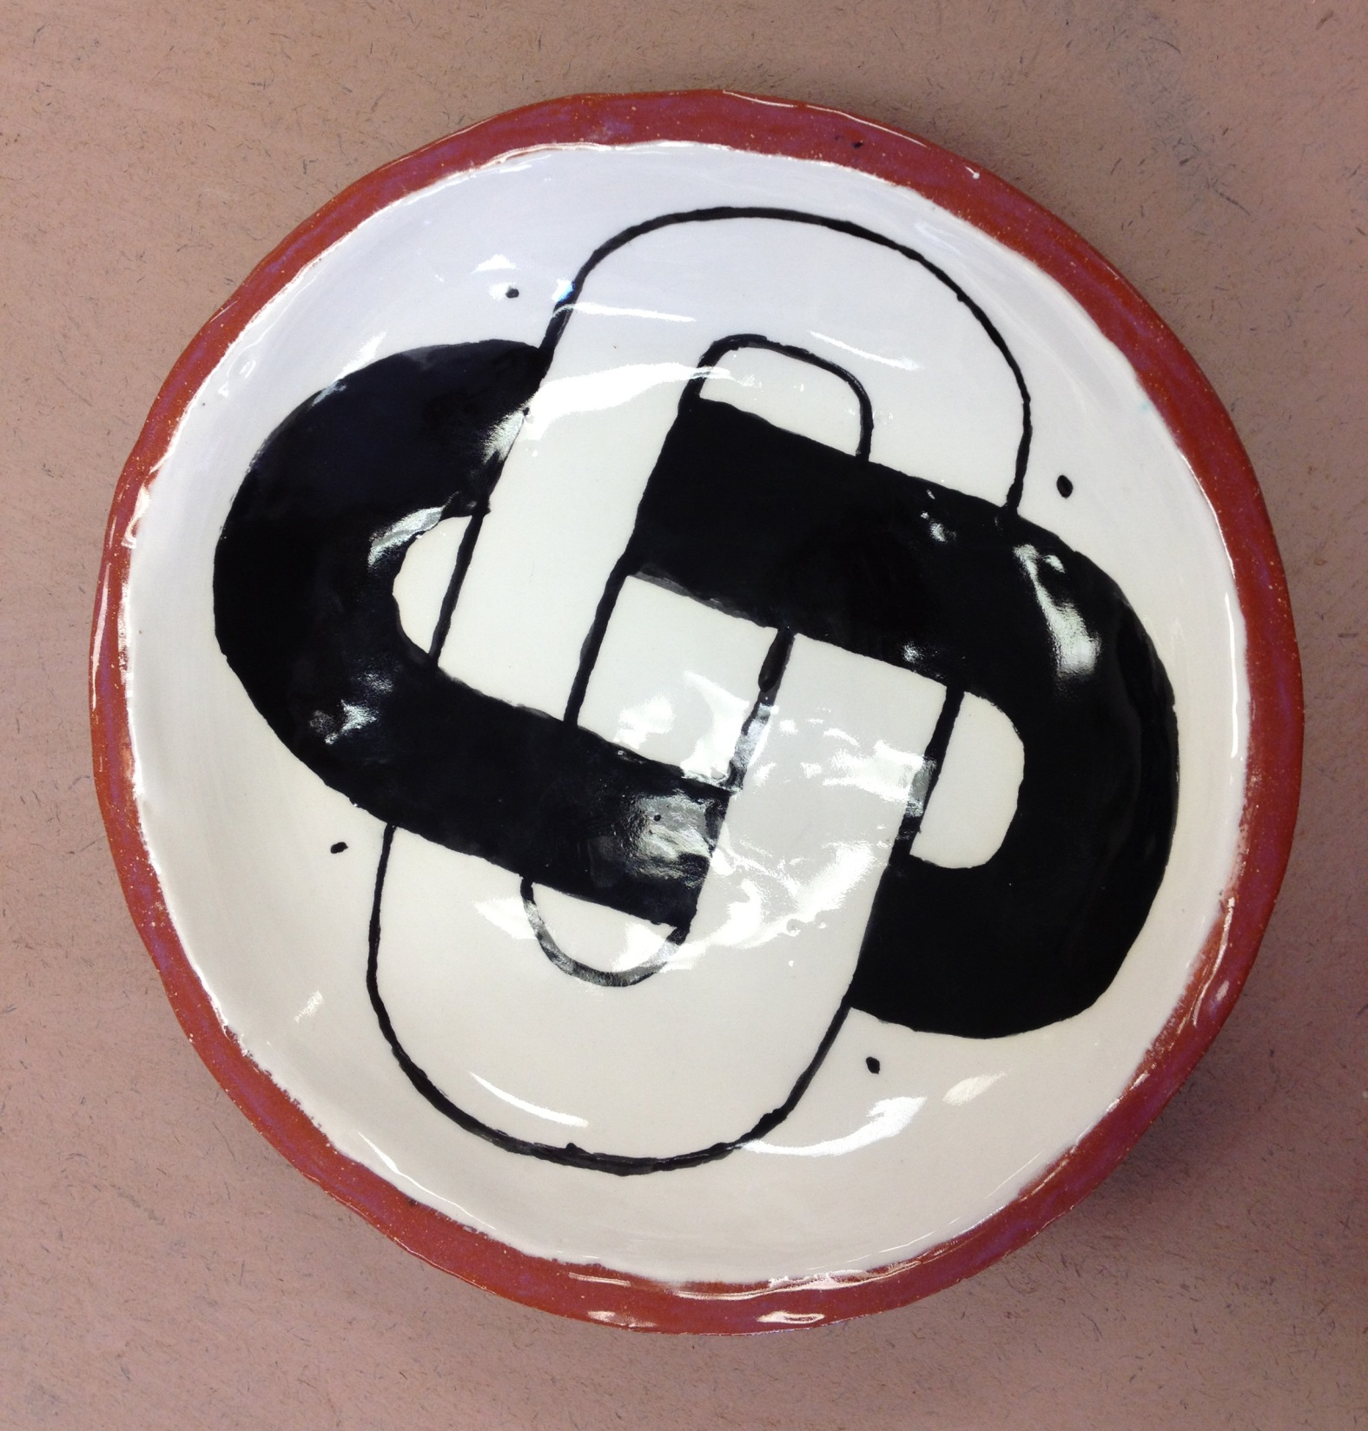

Slide 14
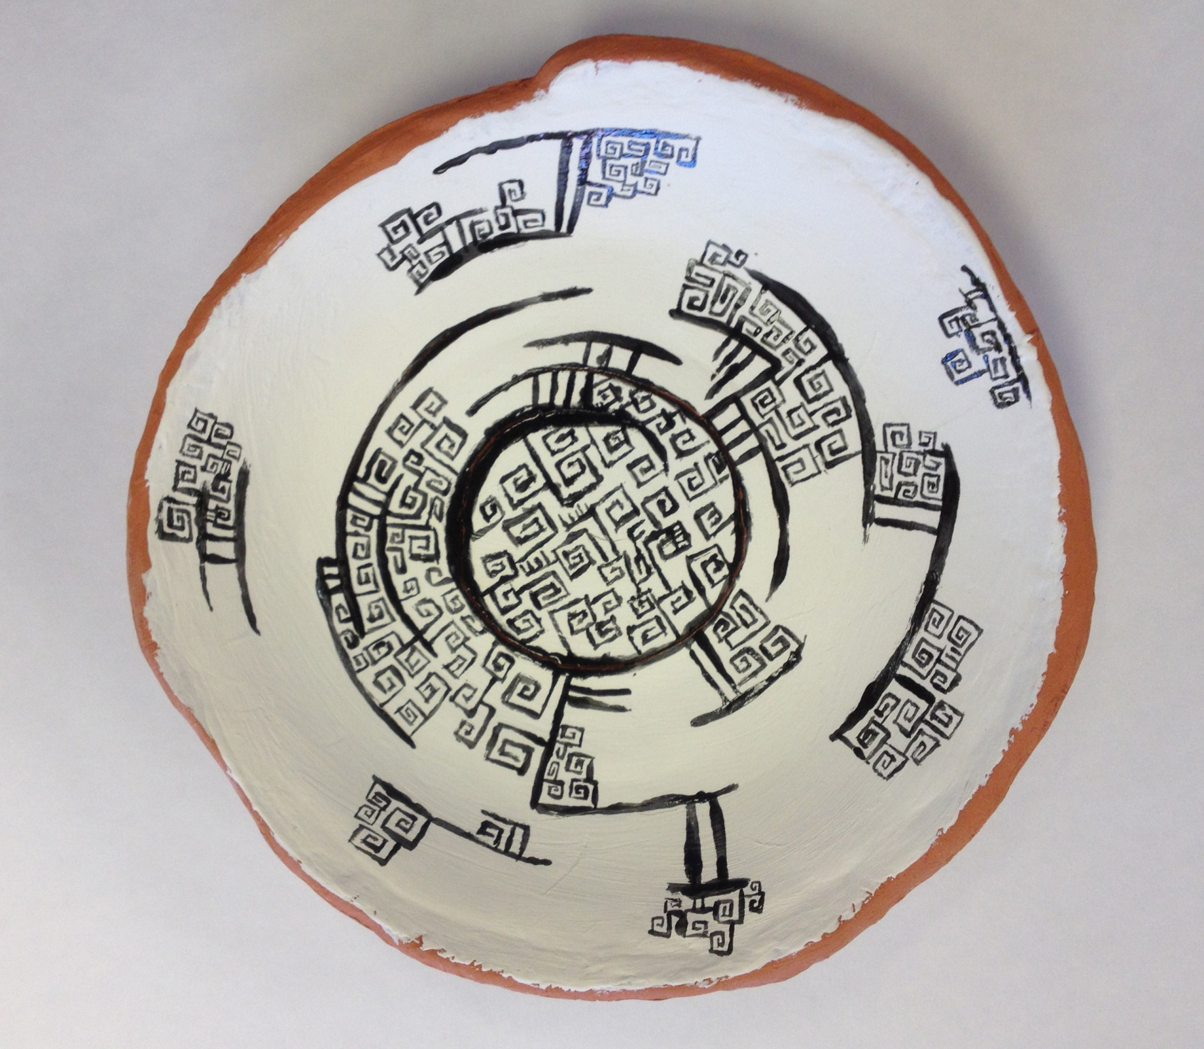

Slide 15
