Slide 1
Ceramic Masks

Slide 2
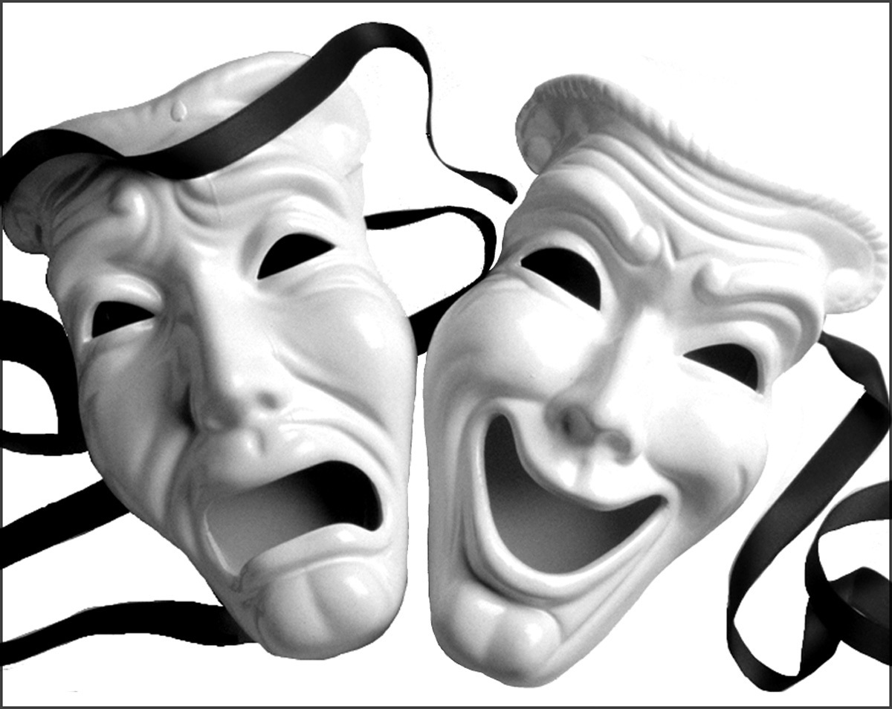
A little history…
Masks can represent so many things: emotions Good, Bad, Fear, Love, and Power.
Greek theater drama masks represent comedy and tragedy

Slide 3
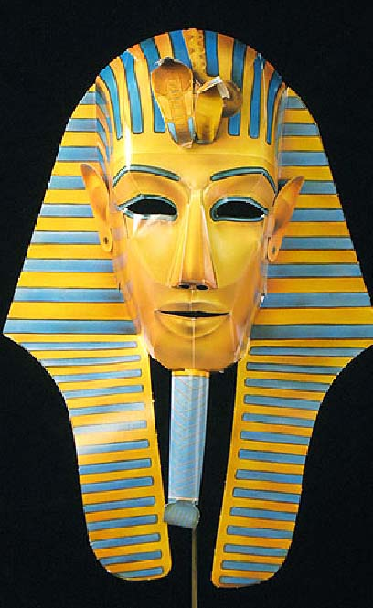
Early death masks from the Egyptians influenced the Romans to also create masks for their departed.
Masks we know in our museums can represent a God, an animal, or even a past King.

Slide 4
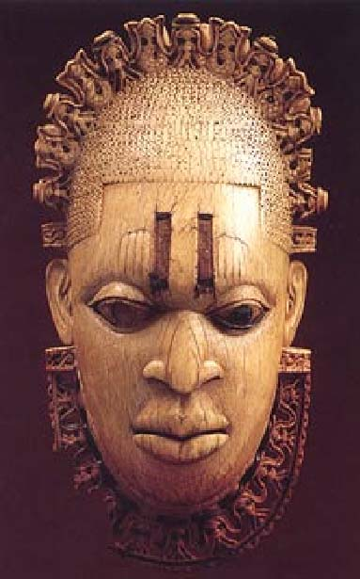
African tribal masks not only distinguish different tribes, areas, and animals but all also fertility, social place, etc.

Slide 5
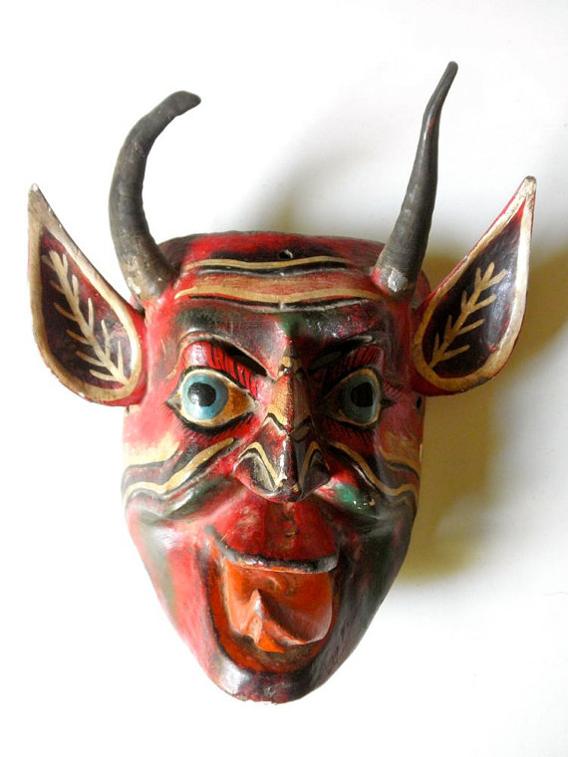
This wooden mask from Guatemala is a representation of El Diablo. These masks are part of the iconographic system of teaching tools created as part of the transition towards Christianity in the 17th century. Each mask portrays a transgression or ‘sin’ that people may face in their everyday lives, such as lust or envy.

Slide 6
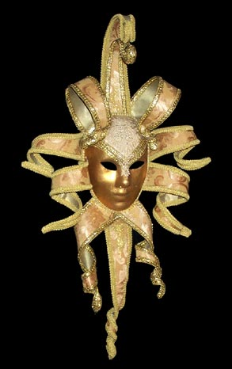
Carnival masks have roots in France and Italy and have spread all the way to New Orleans. These masks are used as a celebration revolving around Lent.

Slide 7
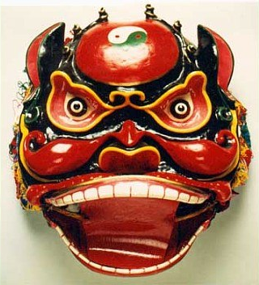
This Chinese Mask is used for the head of a dragon during the Chinese New Year Celebration.

Slide 8
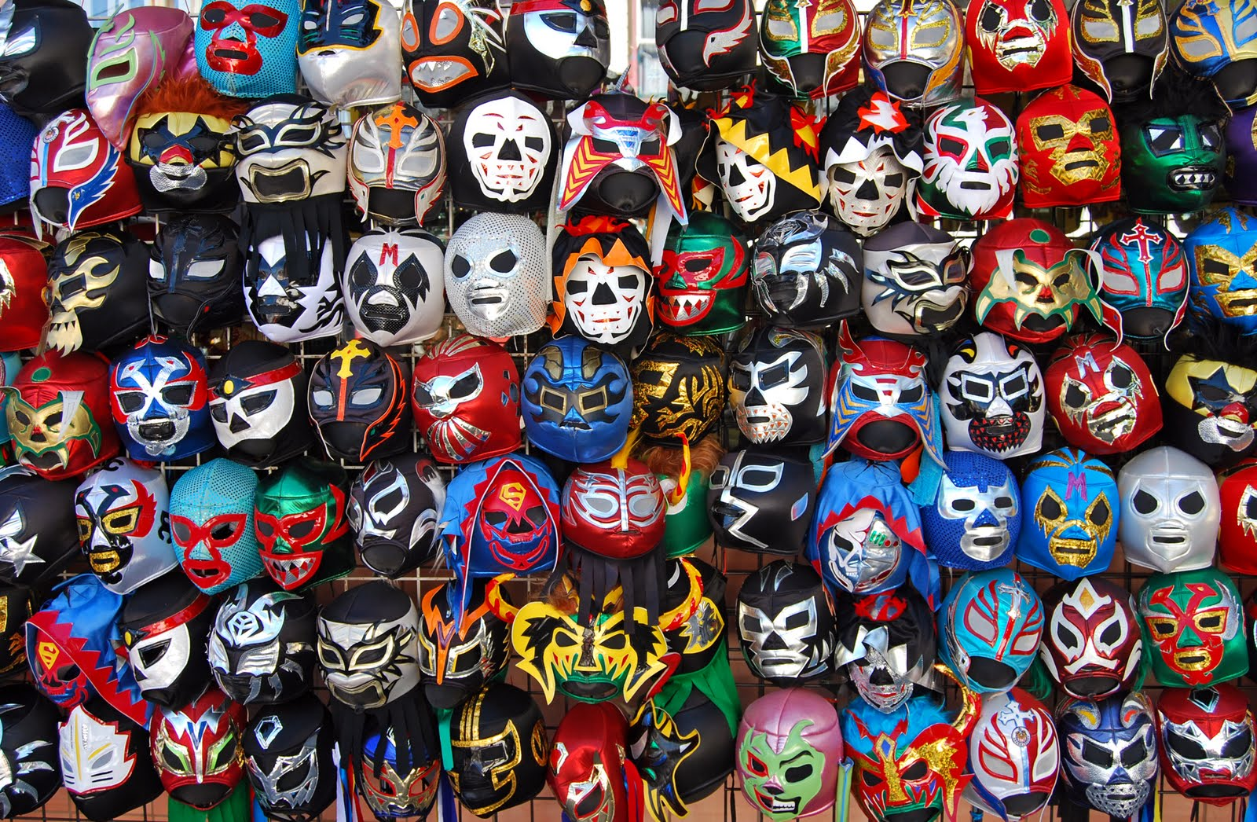
The Lucha Libre Masked Mexican wrestlers hiding their identity are a way masks are used today

Slide 9
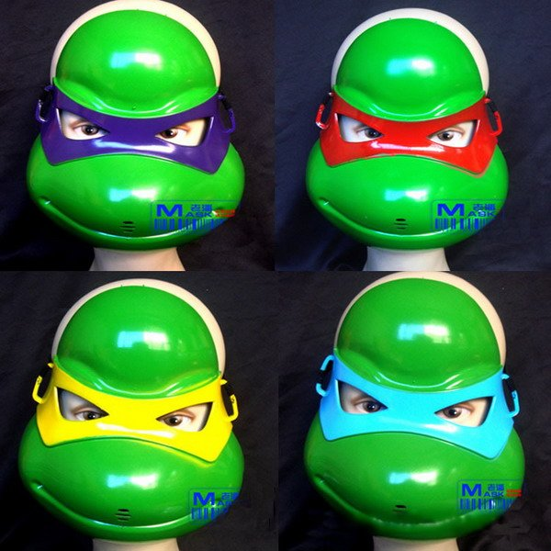
Childhood is filled with masks: The Lone Ranger, Zorro, Green Goblin, Halloween masks, Batman, Spiderman, The Teenage Mutant Ninja Turtles, etcetera.

Slide 10
Examples of Ceramic Masks

Slide 11
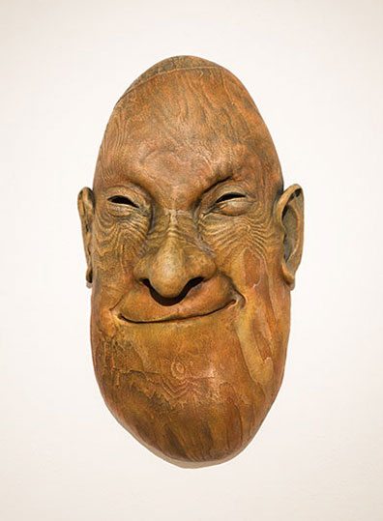
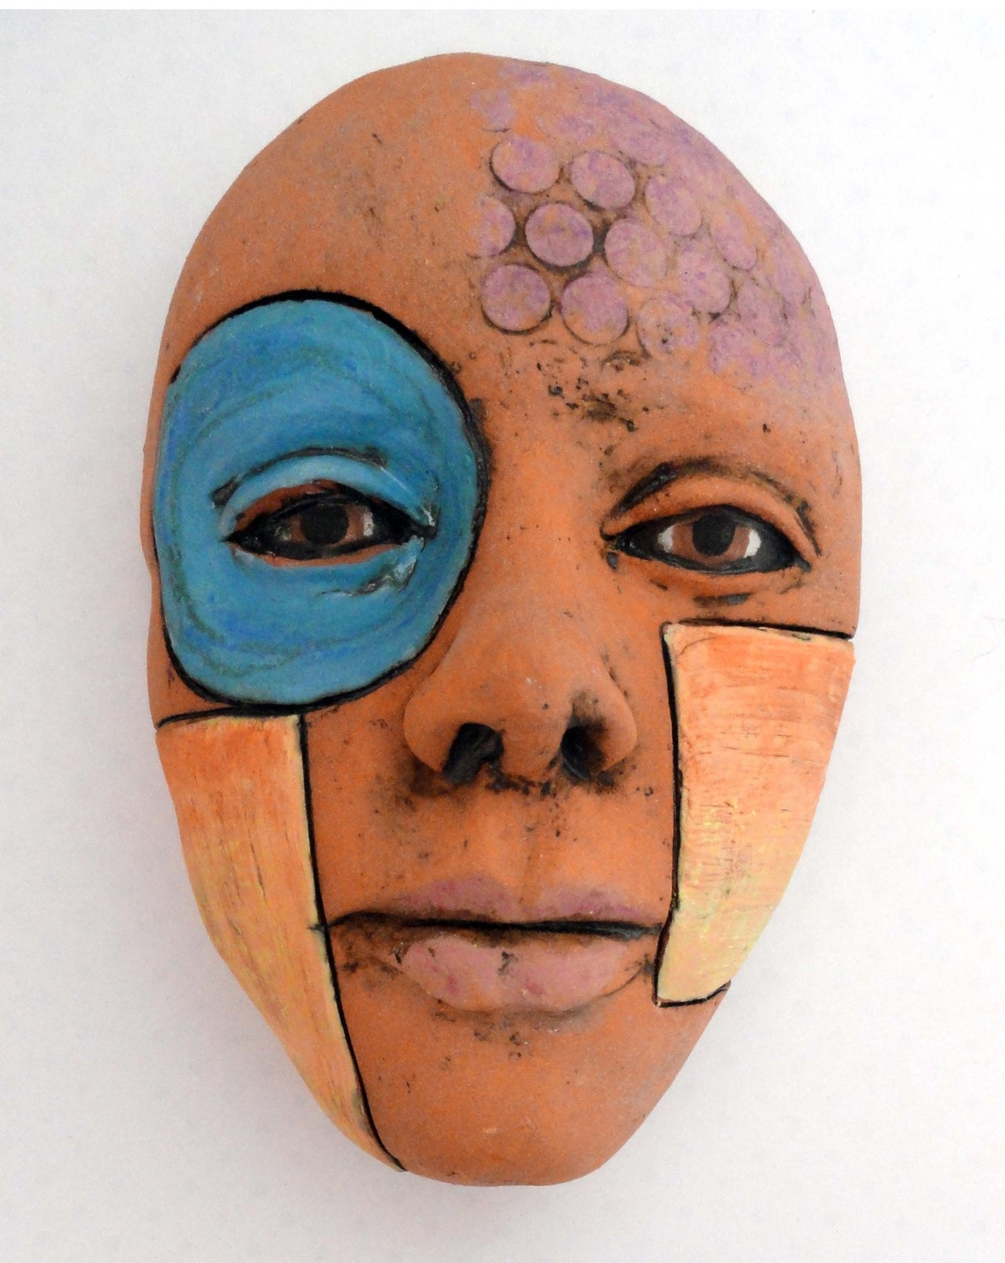

Slide 12
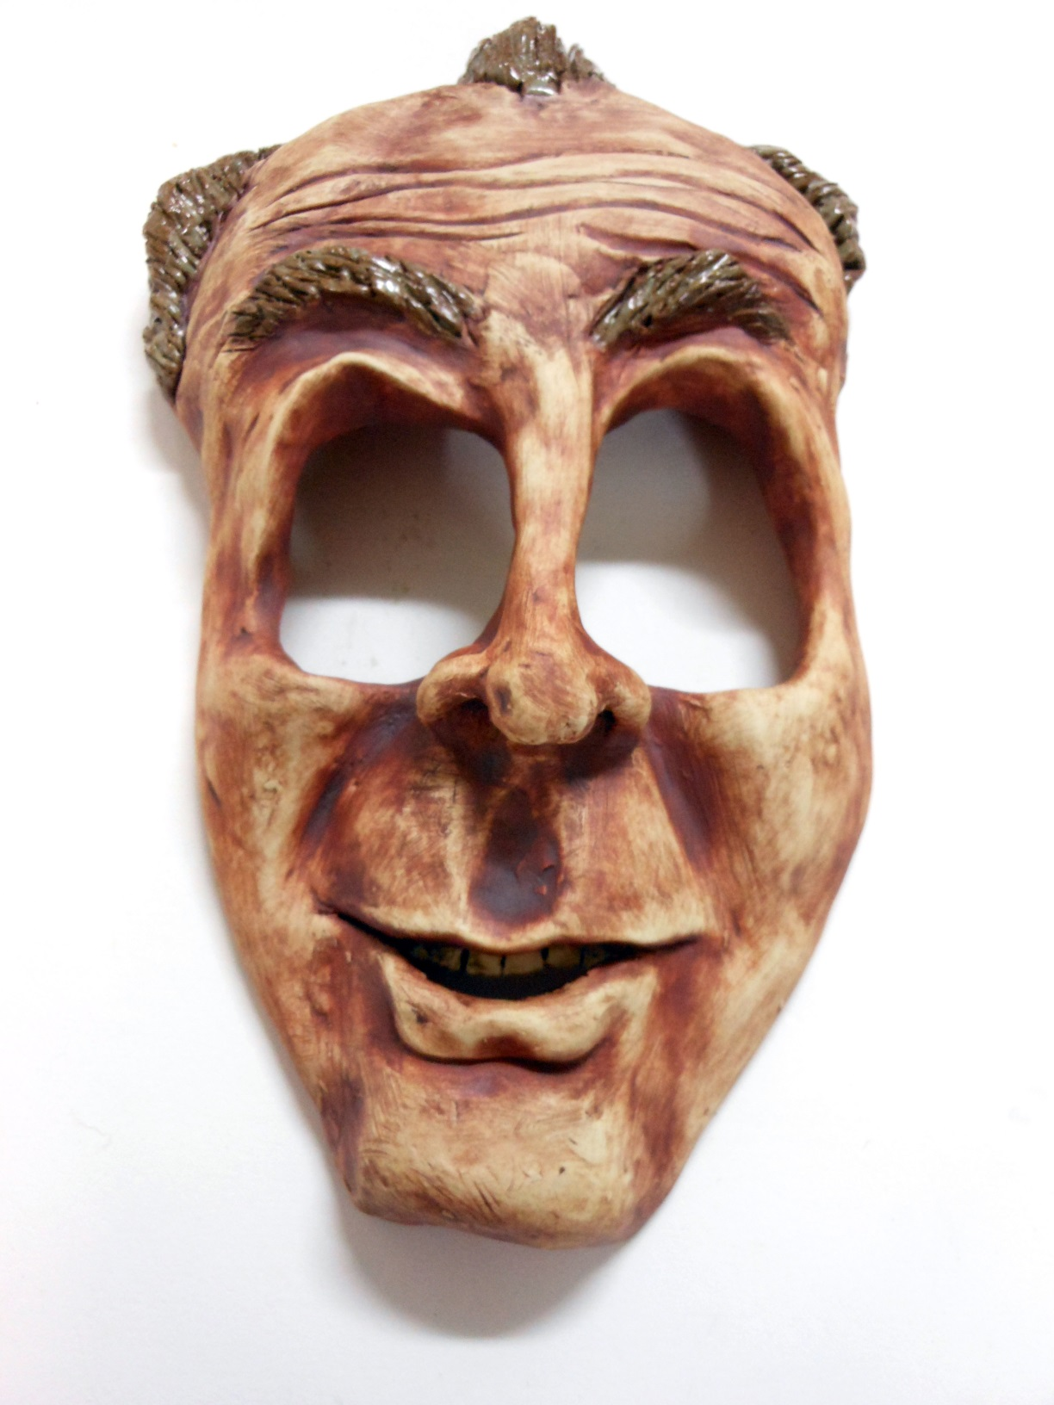
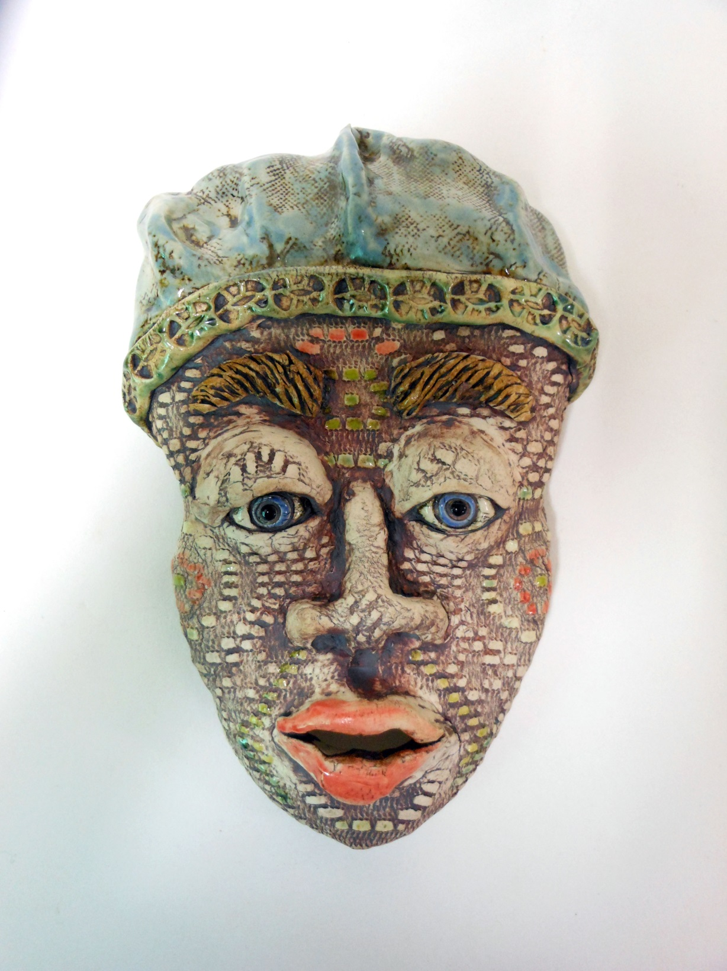

Slide 13
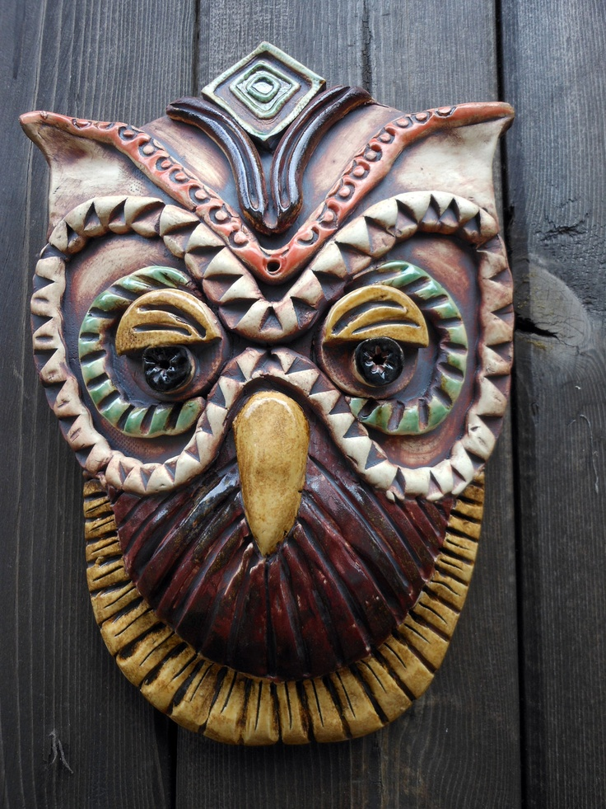
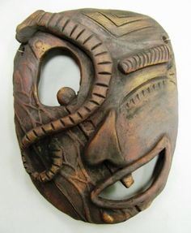

Slide 14
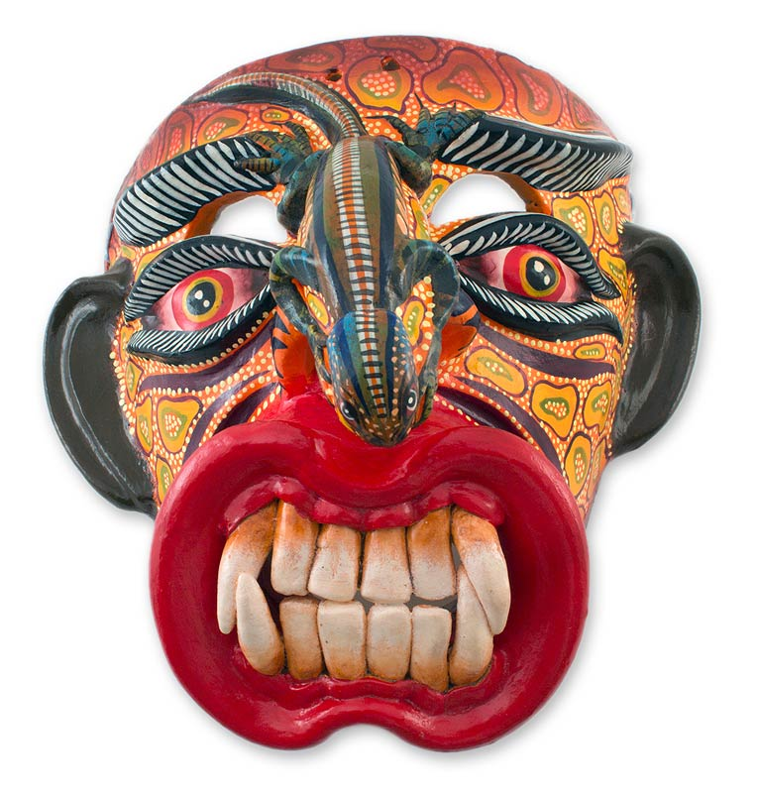

Slide 15
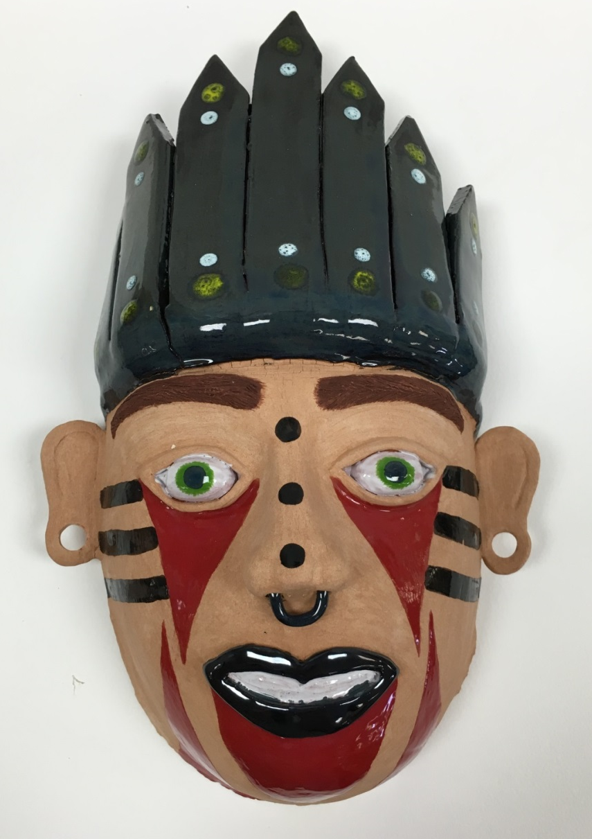
Ceramics I Masks
Use a canvas mask as an armature to structure your piece
Your mask must include at least two facial features (eyes, nose, mouth, ears) – they do not have to be human features.
Your mask should be a representation of your personality OR the personality of your alter-ego

Slide 16
Examples of Student Ceramic Masks

Slide 17
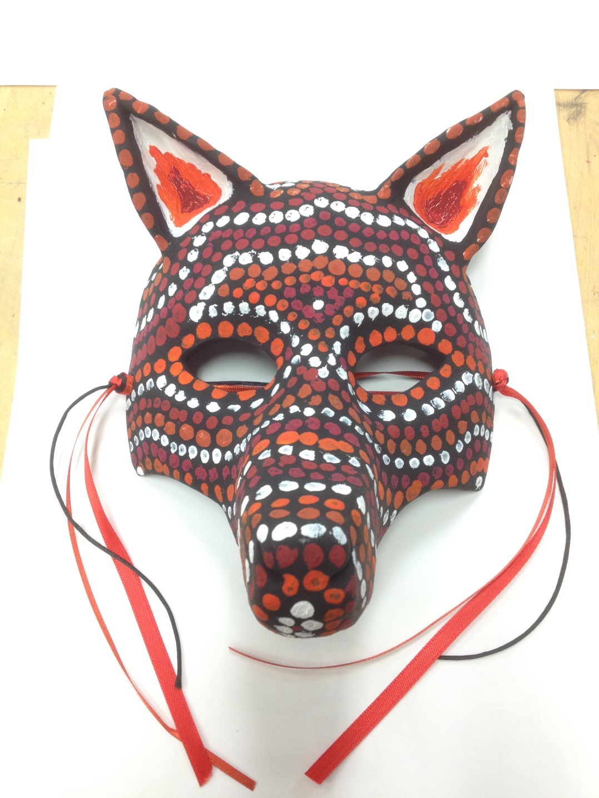
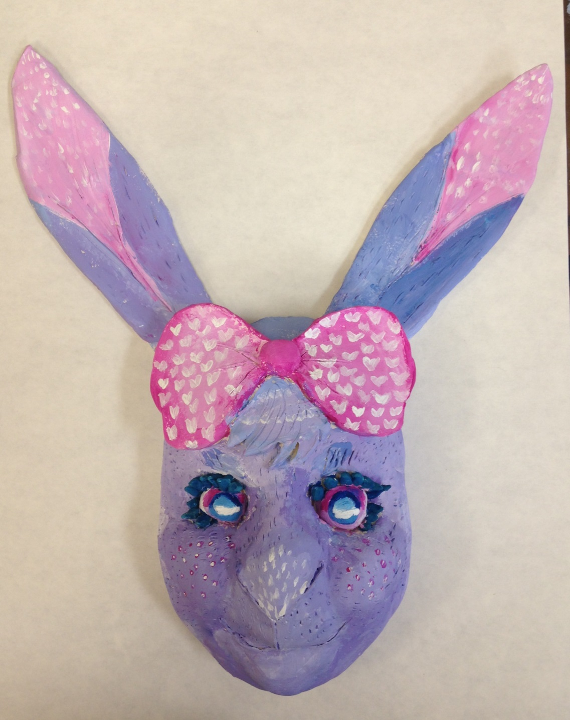

Slide 18
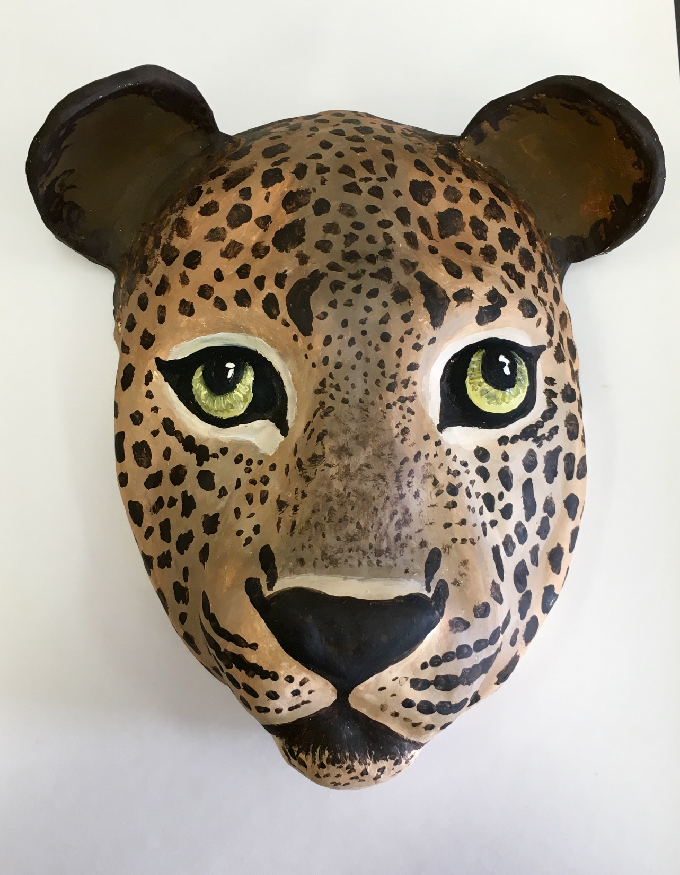

Slide 19
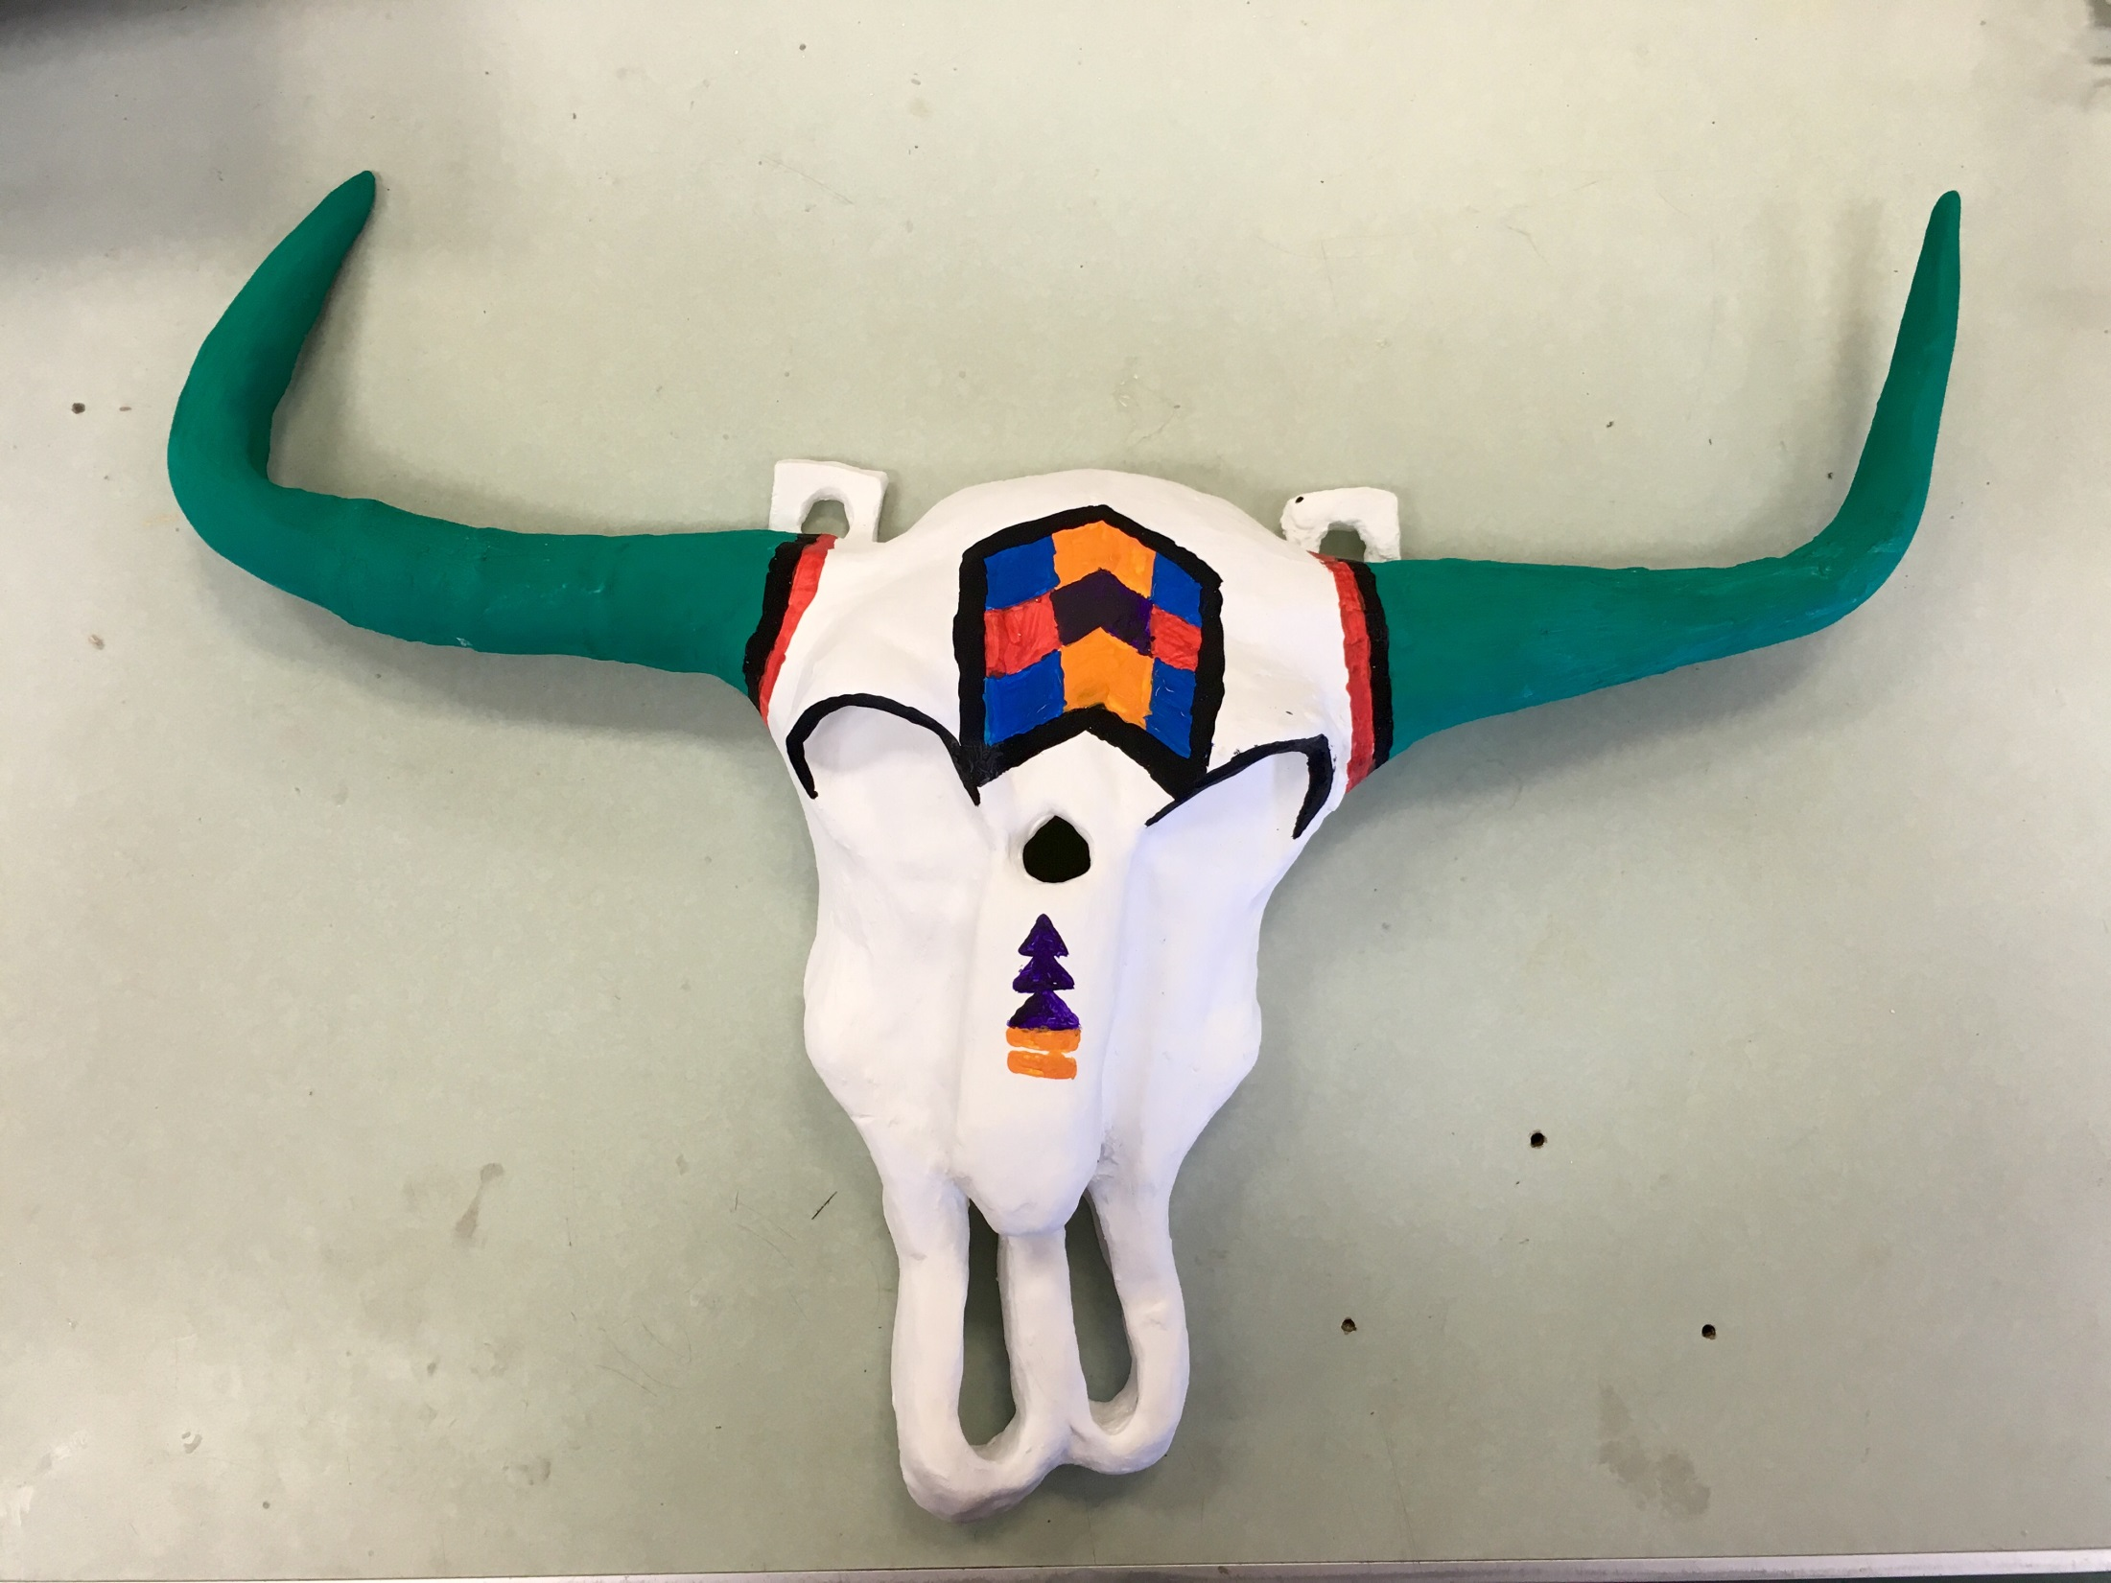

Slide 20
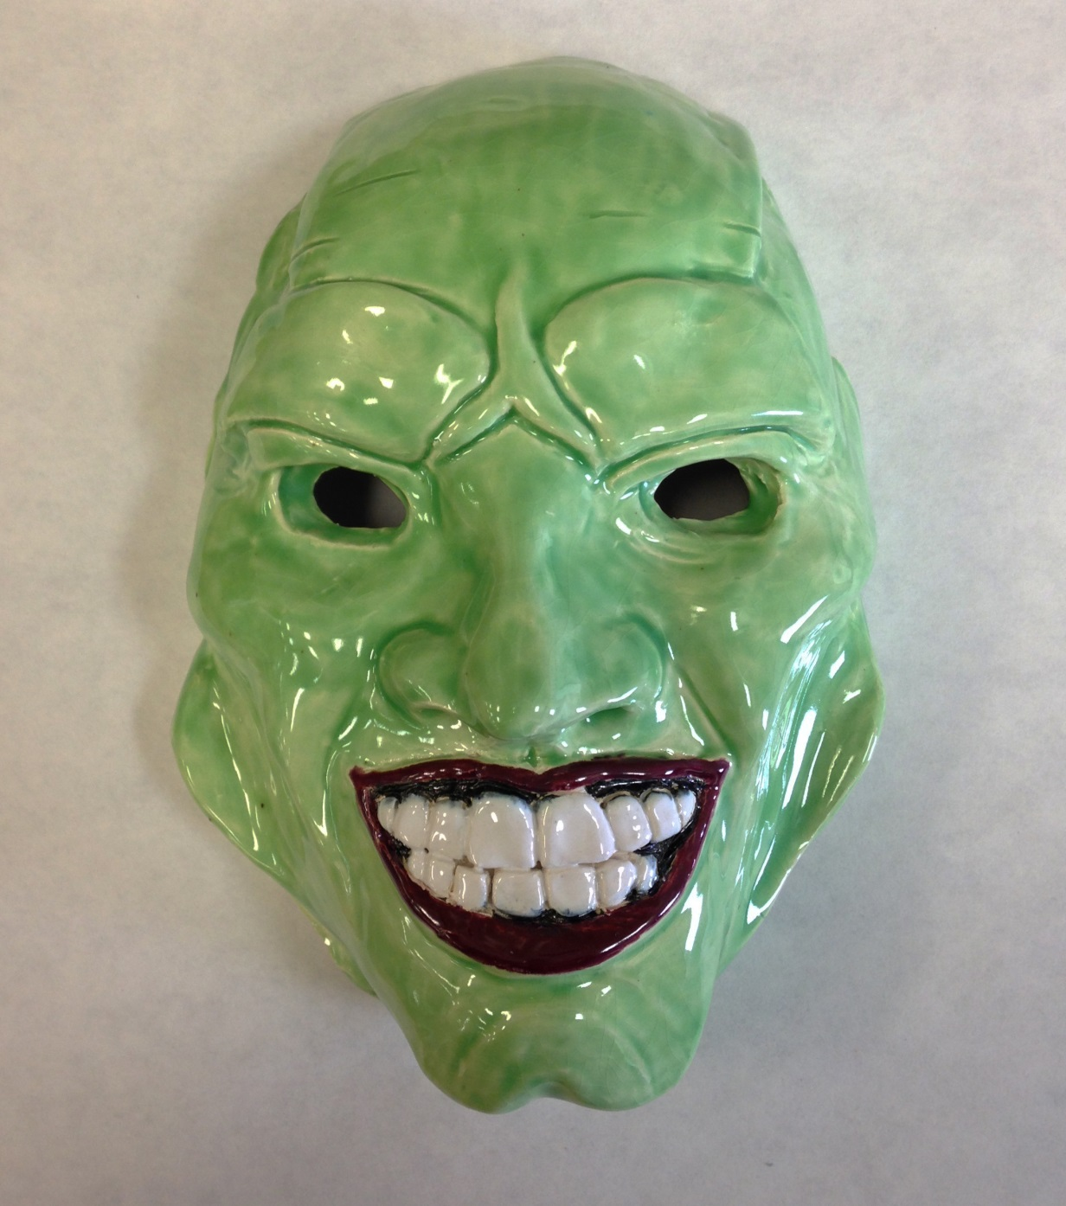
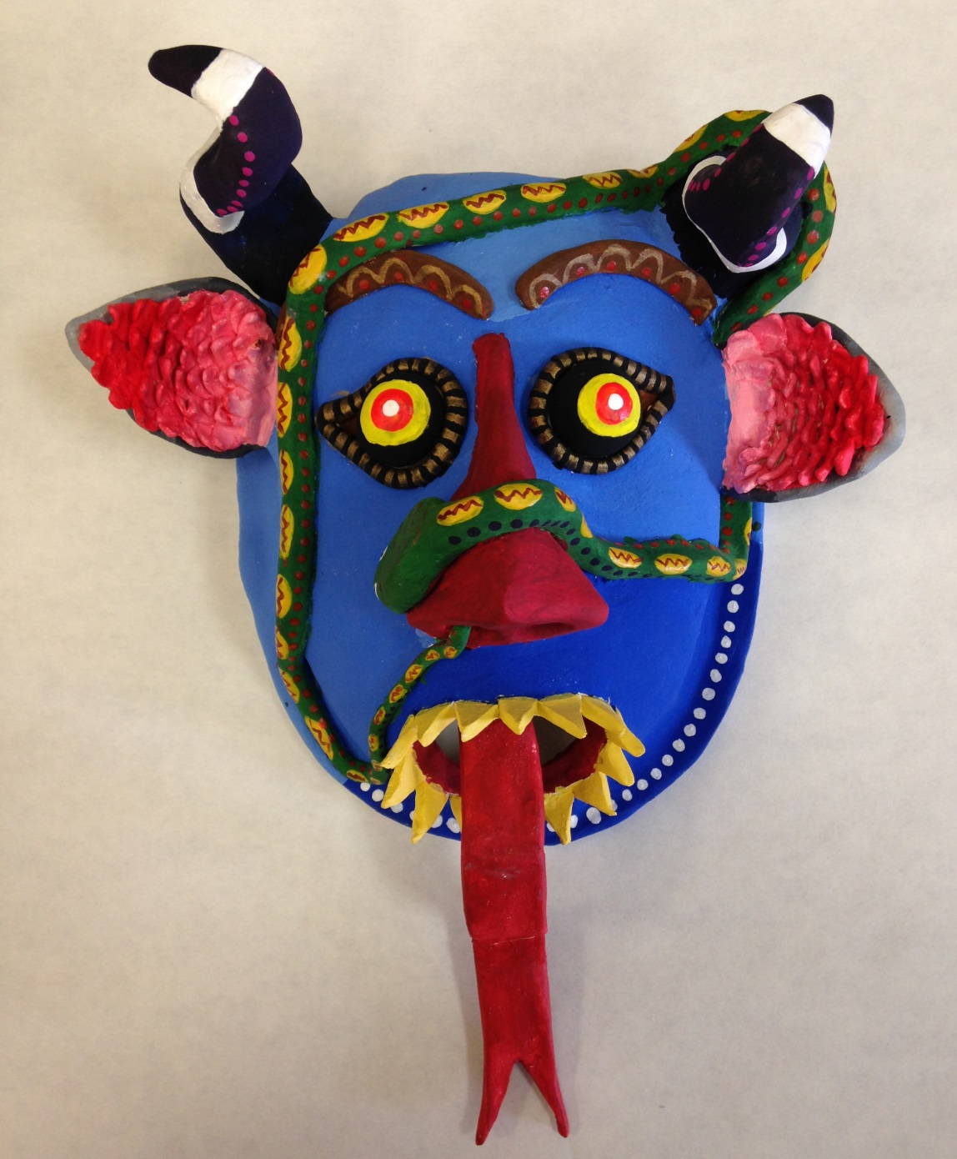

Slide 21
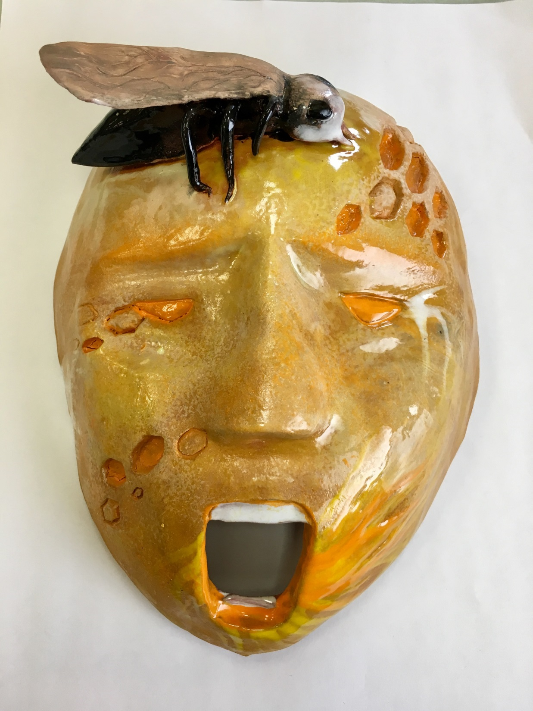
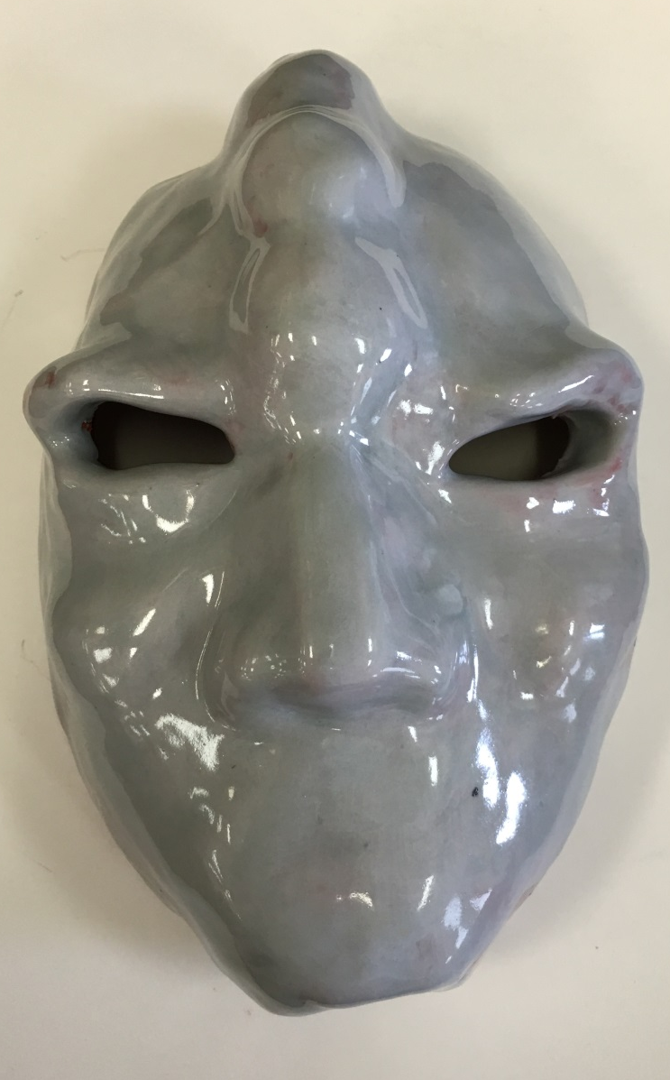

Slide 22
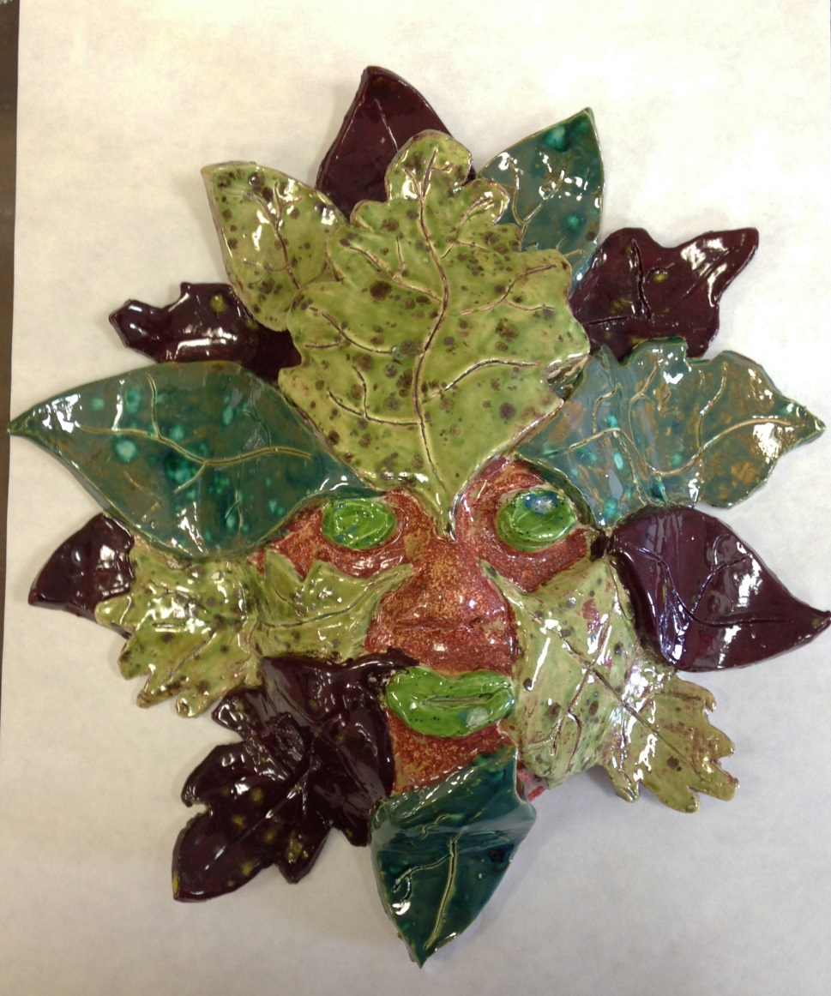
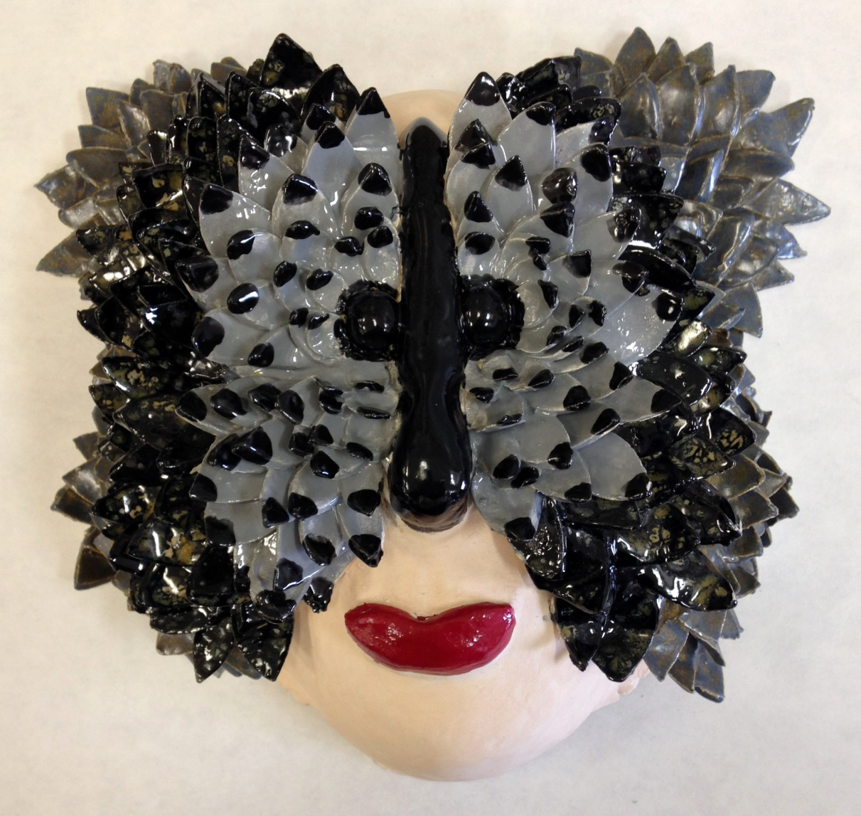

Slide 23
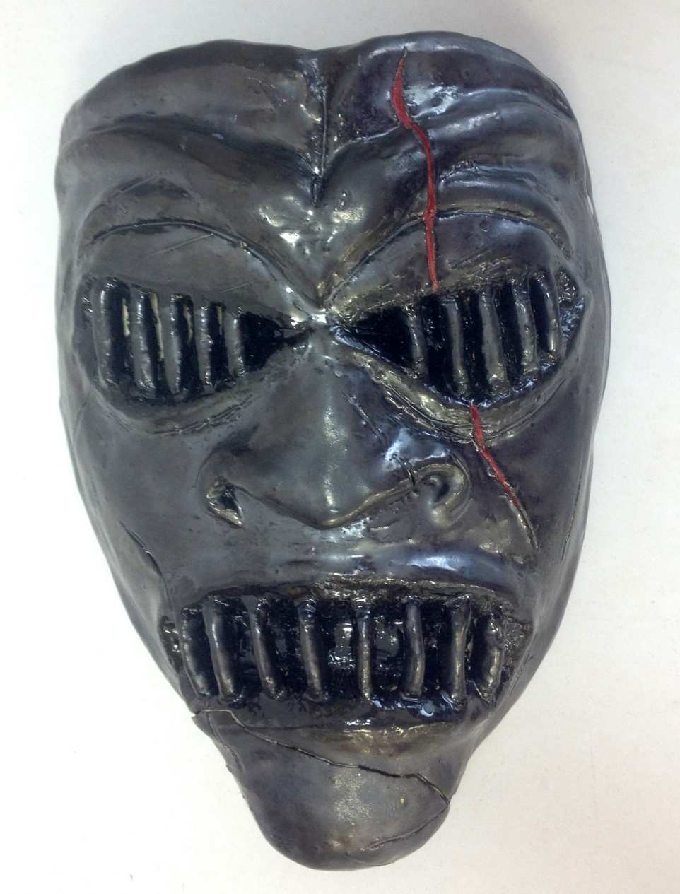
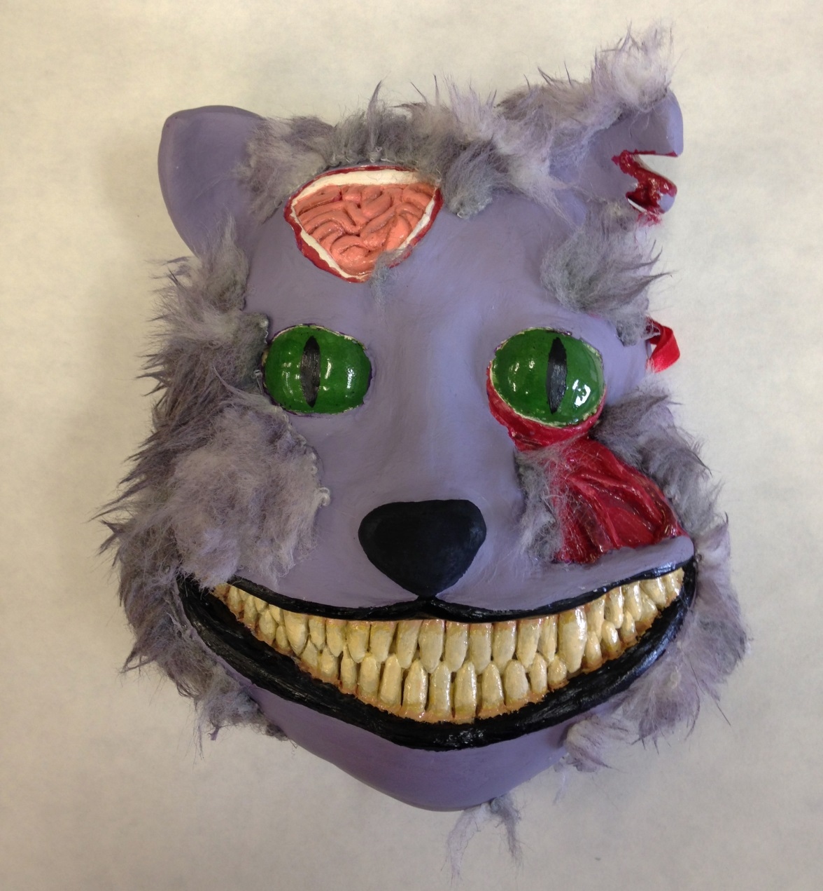

Slide 24
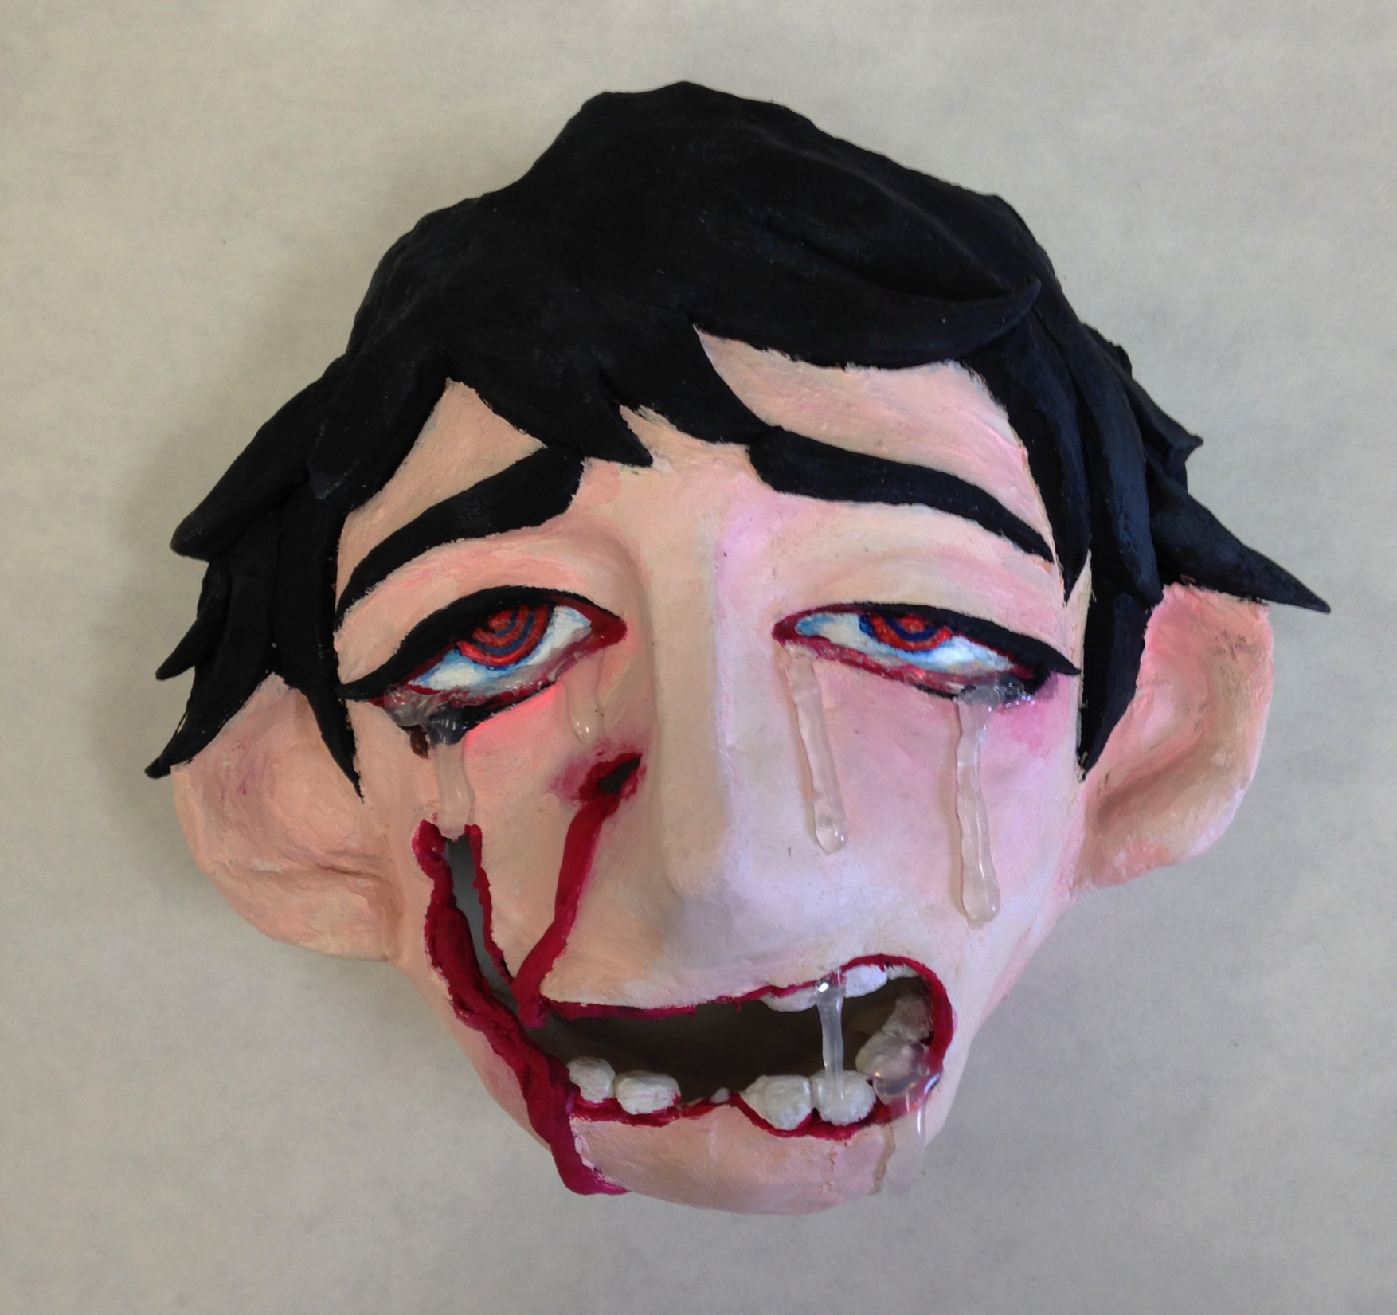

Slide 25
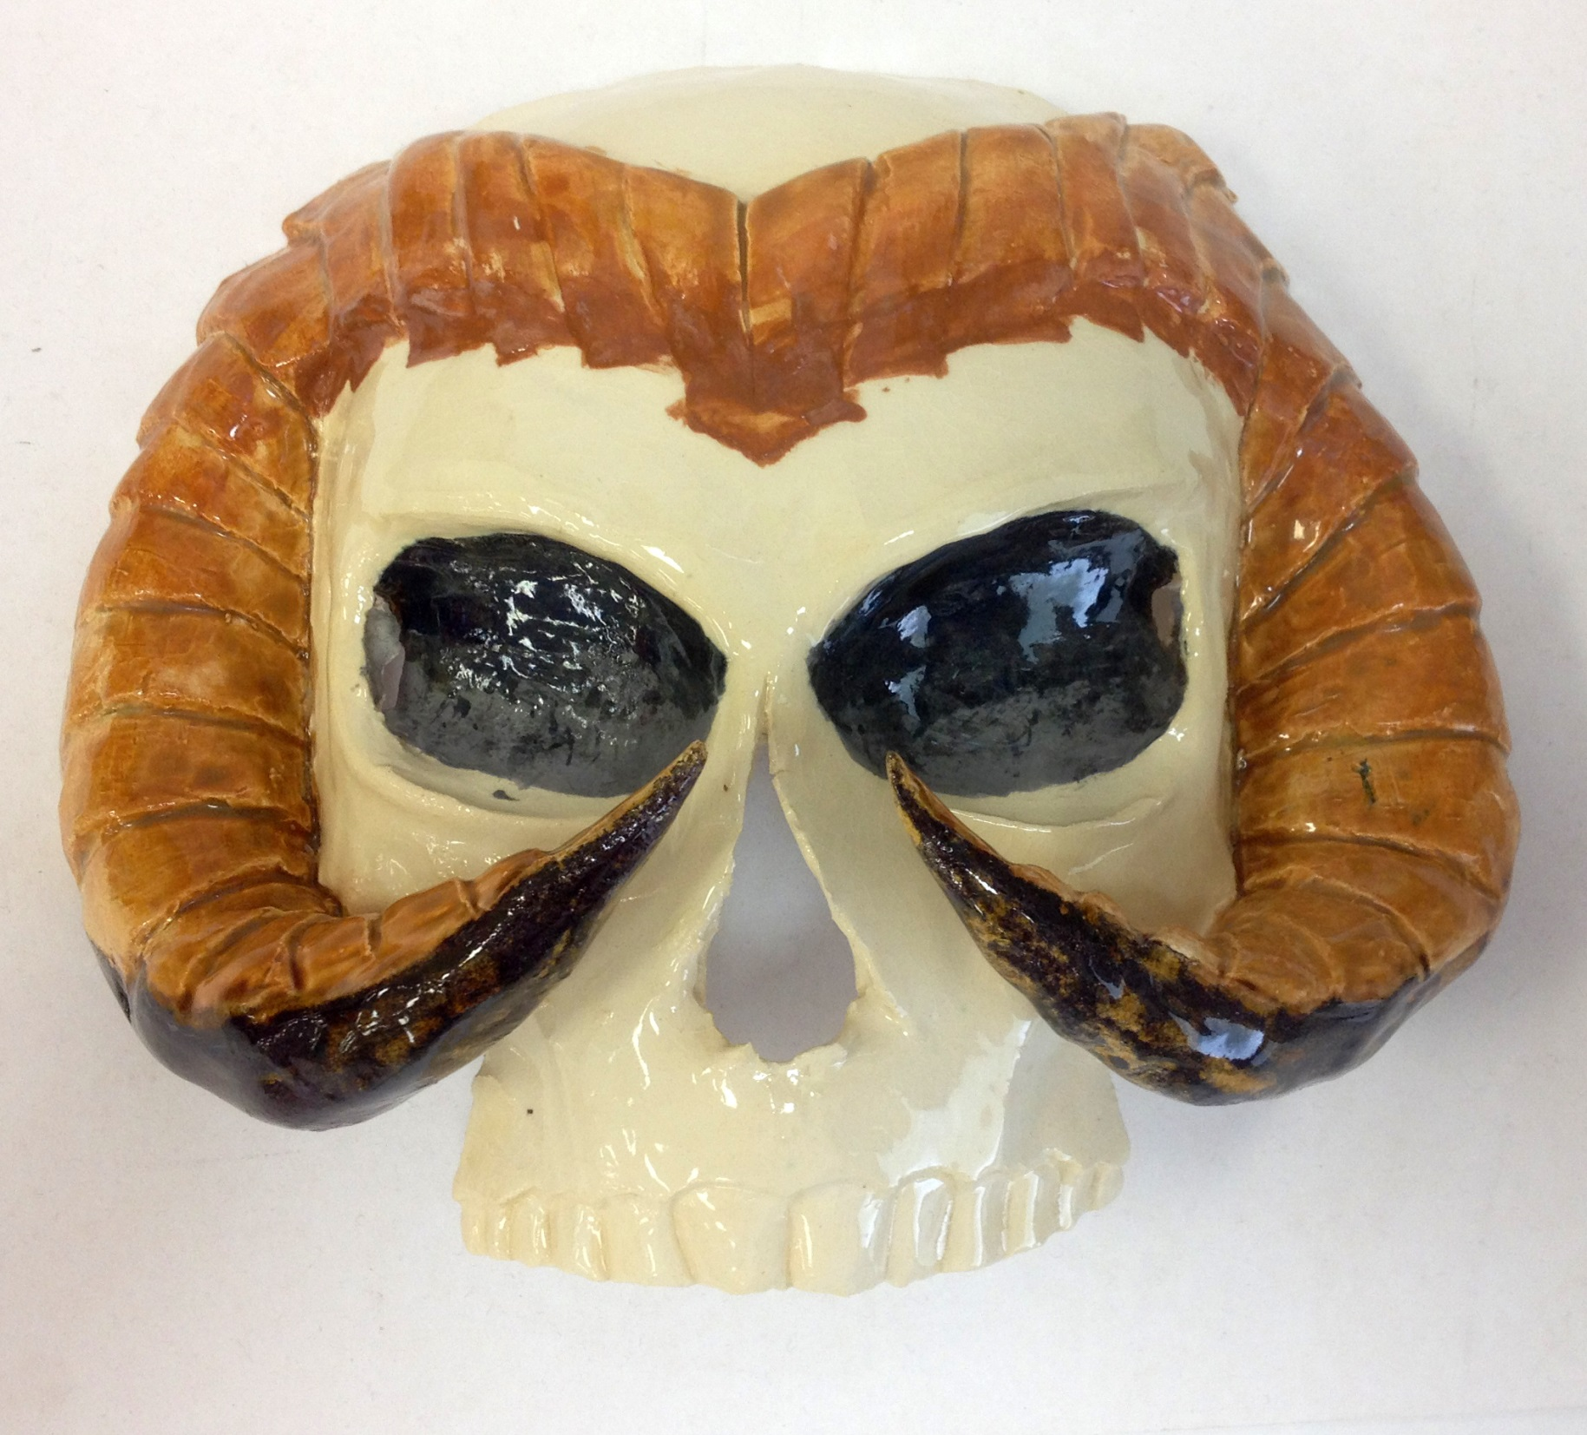

Slide 26
How To Make a Clay Mask

