Slide 1
Dwellings
● Students must create a dwelling and an inhabitant that lives in
that dwelling (so they must go together).
● Students will use stoneware clay to sculpt their dwelling and glaze
● Get creative! Make something unique that we haven’t seen before!
● But remember to keep it school appropriate
● To start creating, think about using a slab technique (like your tiles)
or a pinching technique. Otherwise, try to think of your project in
the simplest shapes possible and start from there.
● The more thought you put into your sketches, the easier creating
with clay will be!

Slide 2
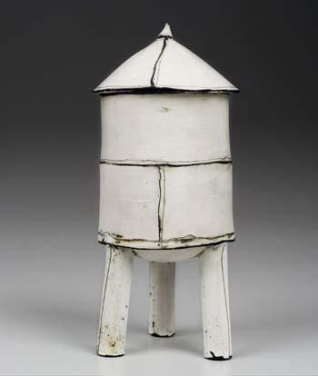
Mary Fischer
Mary Fischer believes that building with extruded pieces is like playing with Legos. The more pieces you have to play with, the more you can move things around until the right combination appears. Some works include multiple pieces that are not attached so that playing can continue, arranging and rearranging as fancy dictates. The buildings started as boxes. Lids became roofs. Feet and chimneys appeared and things go on from there, changing from season to season.

Slide 3
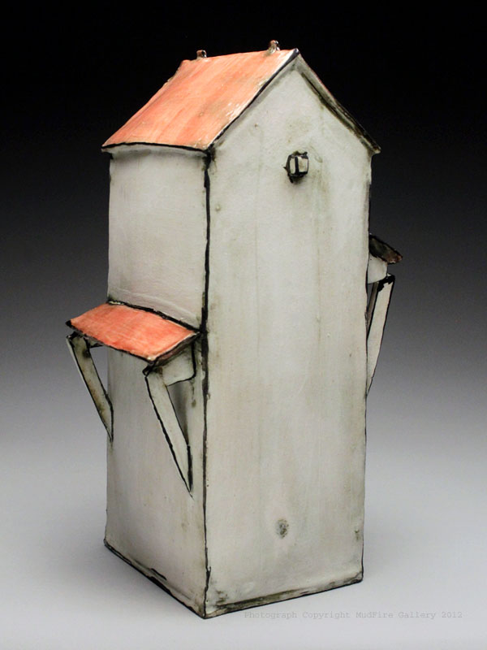
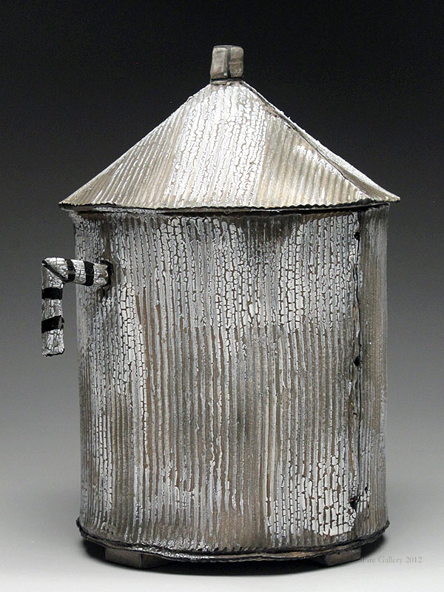
Mary Fischer, Grain Bin, 2012
Mary Fischer, Tall House, 2012

Slide 4
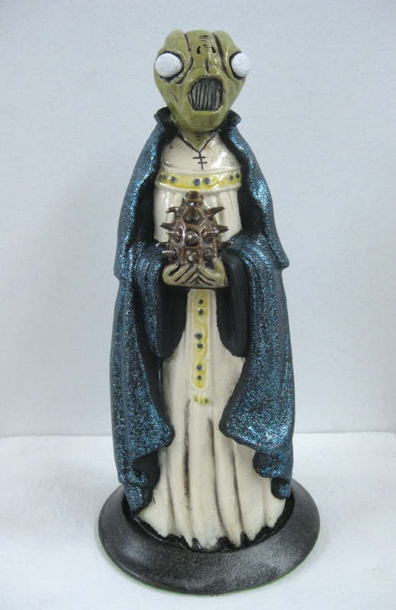
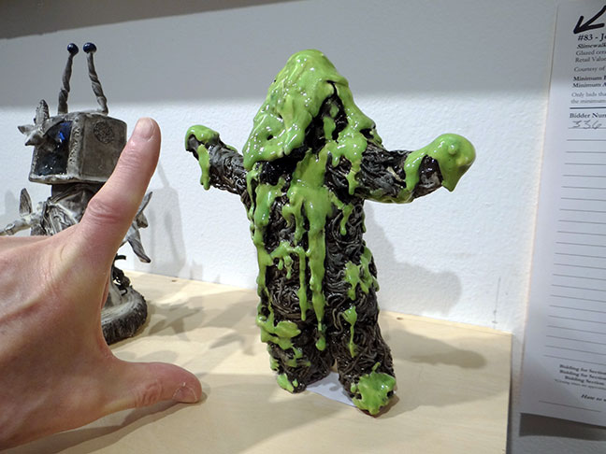
Joshua Reinstein
Green Slimey Man
John Berggruen Gallery
American Artist
2013

Slide 5
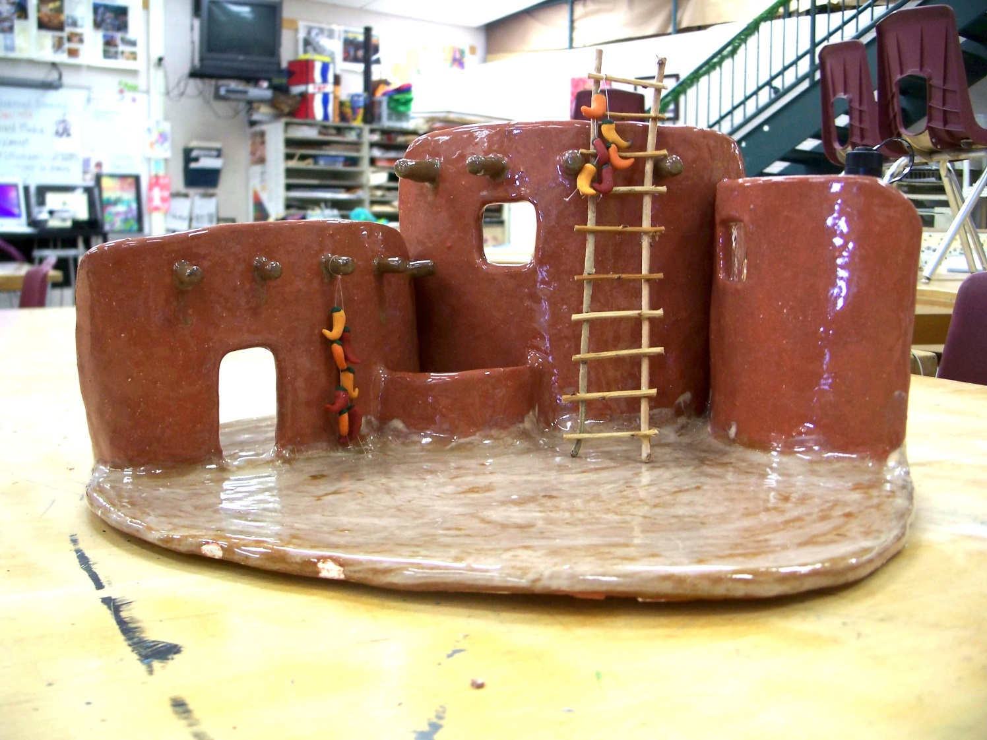
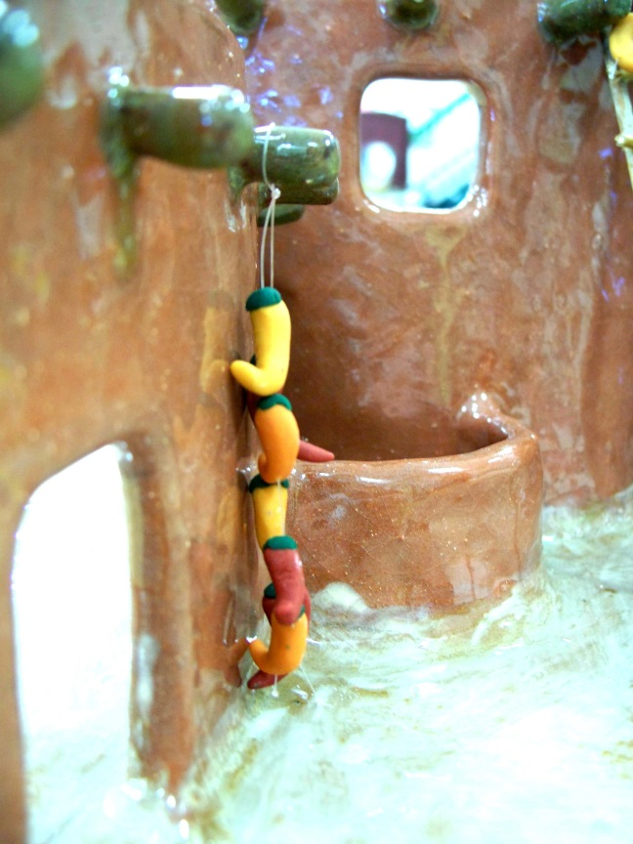
Student Examples

Slide 6
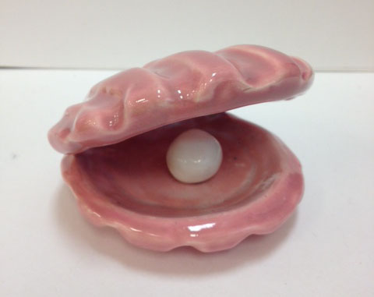
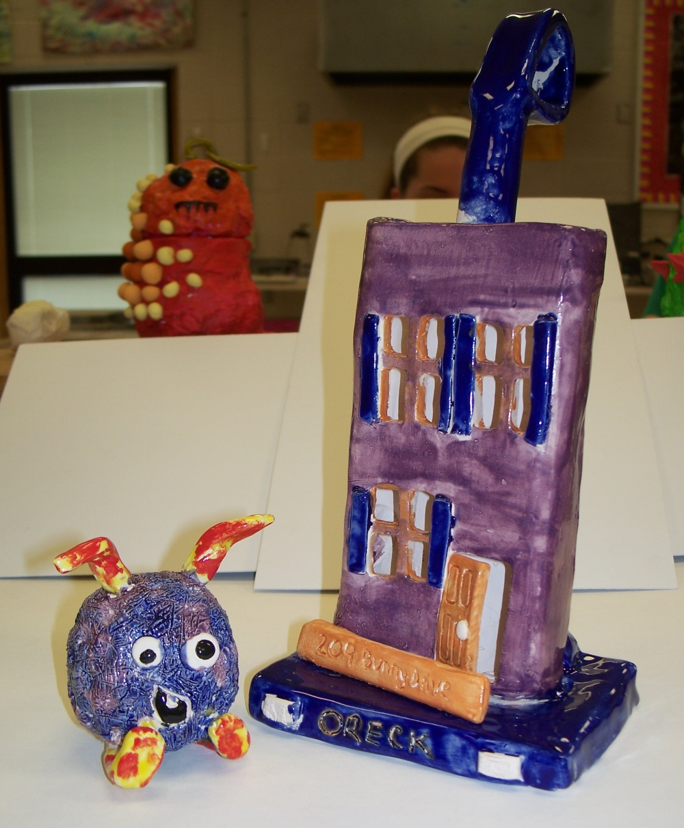
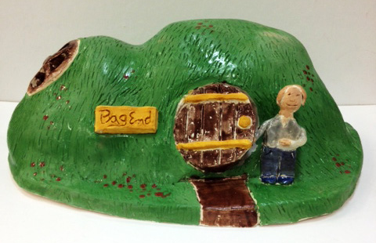

Slide 7
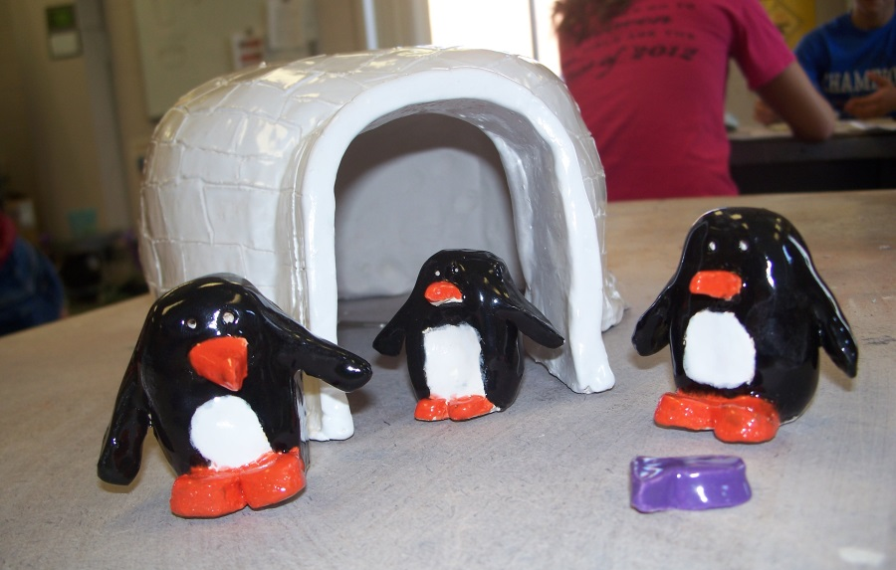
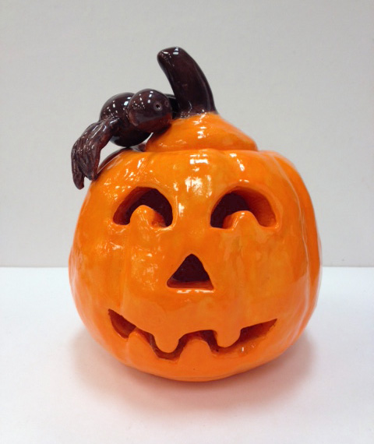

Slide 8
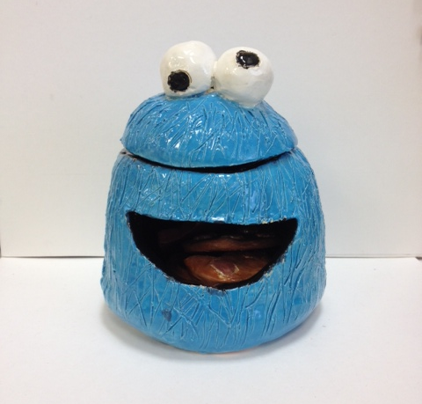
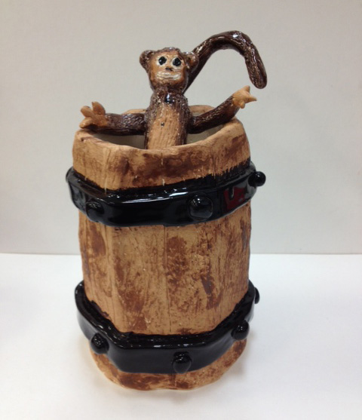
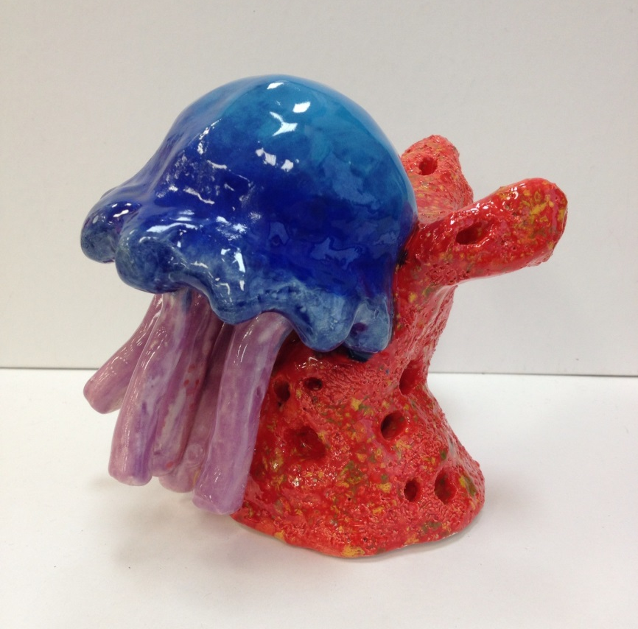

Slide 9
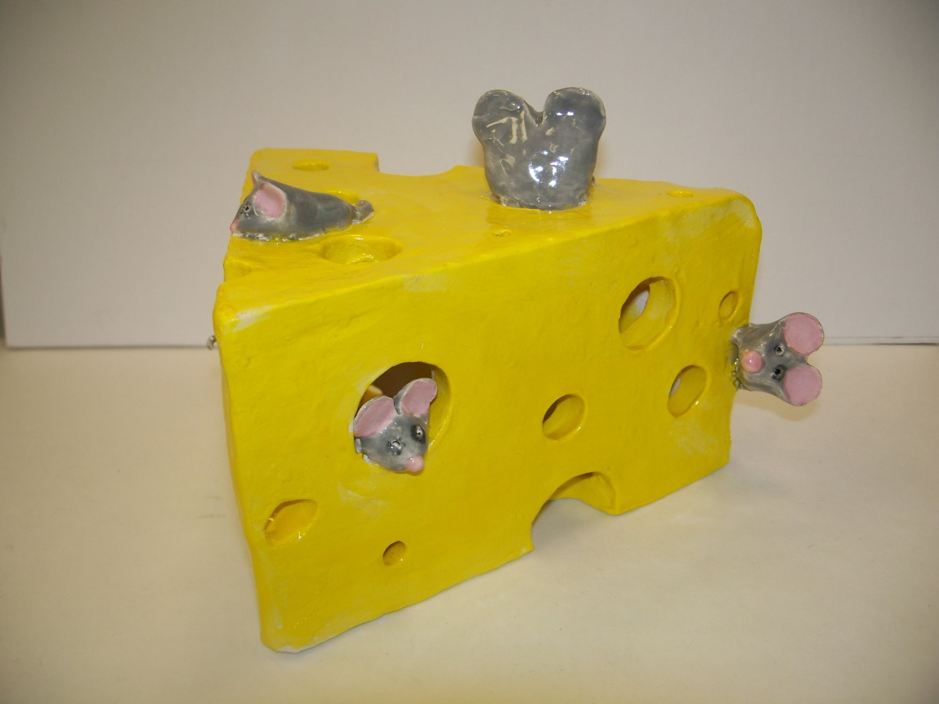
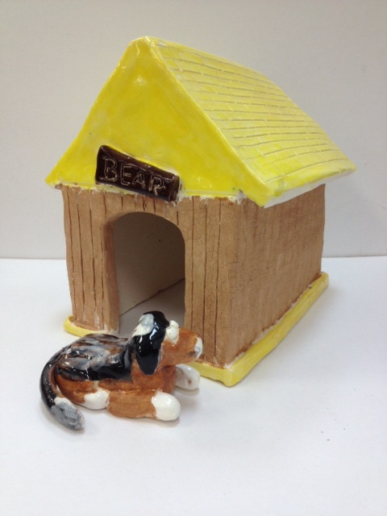
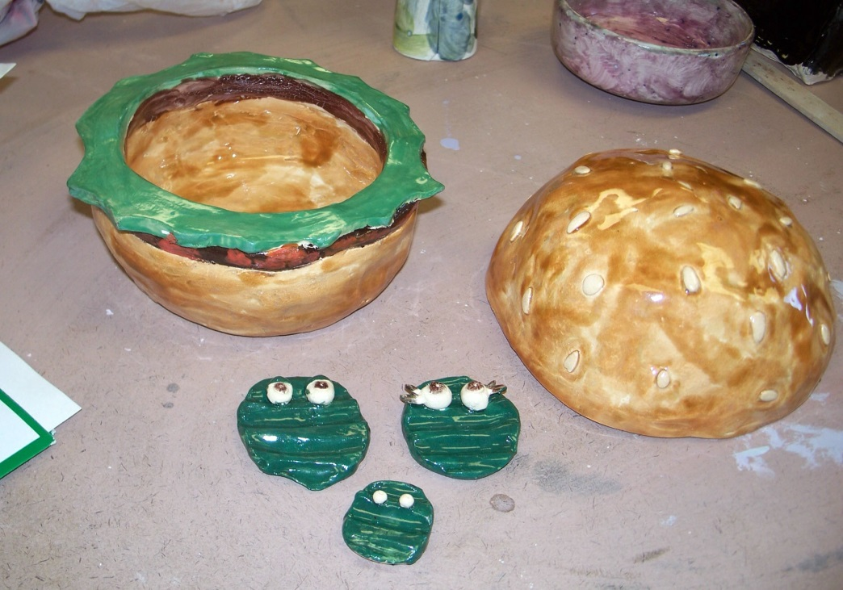

Slide 10
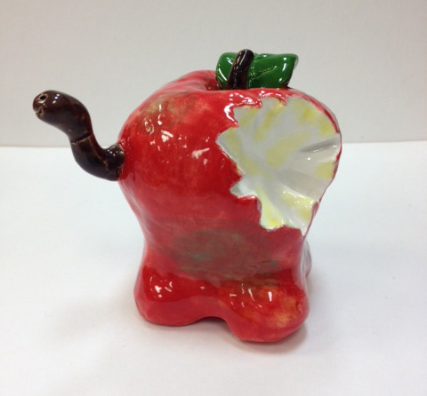
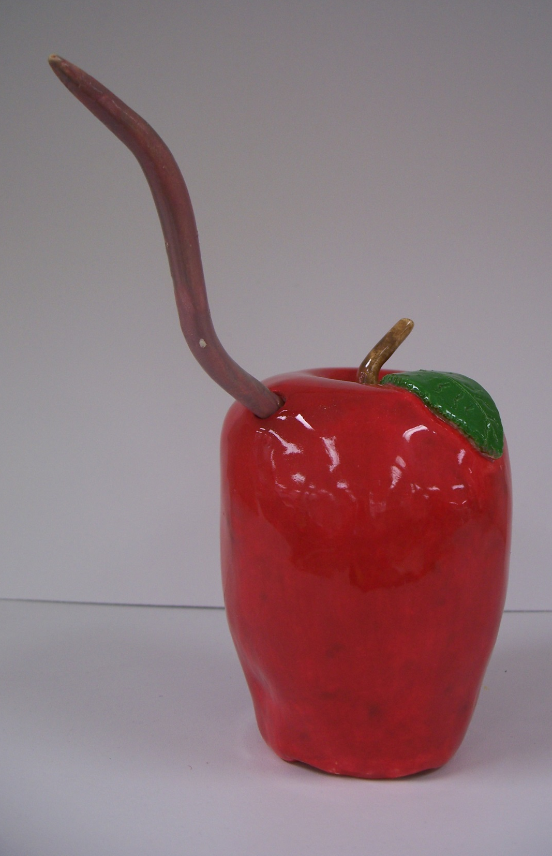
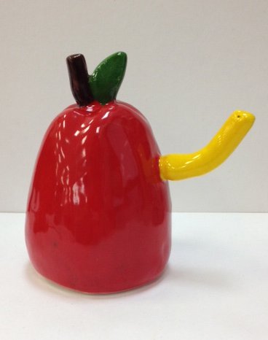

Slide 11
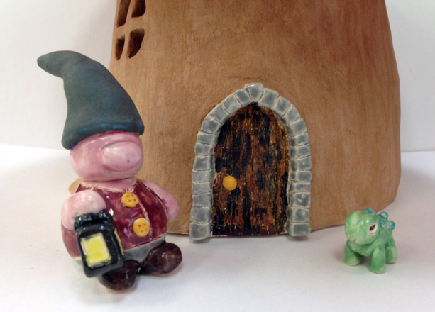
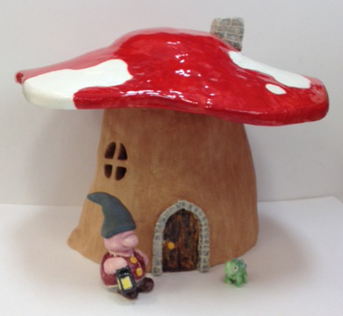

Slide 12
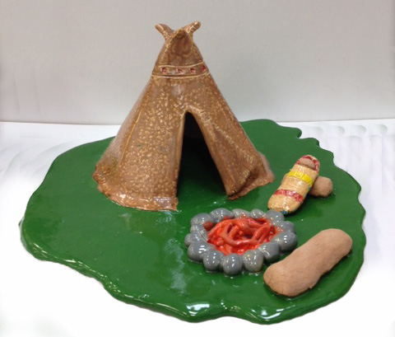

Slide 13
